Slide 1
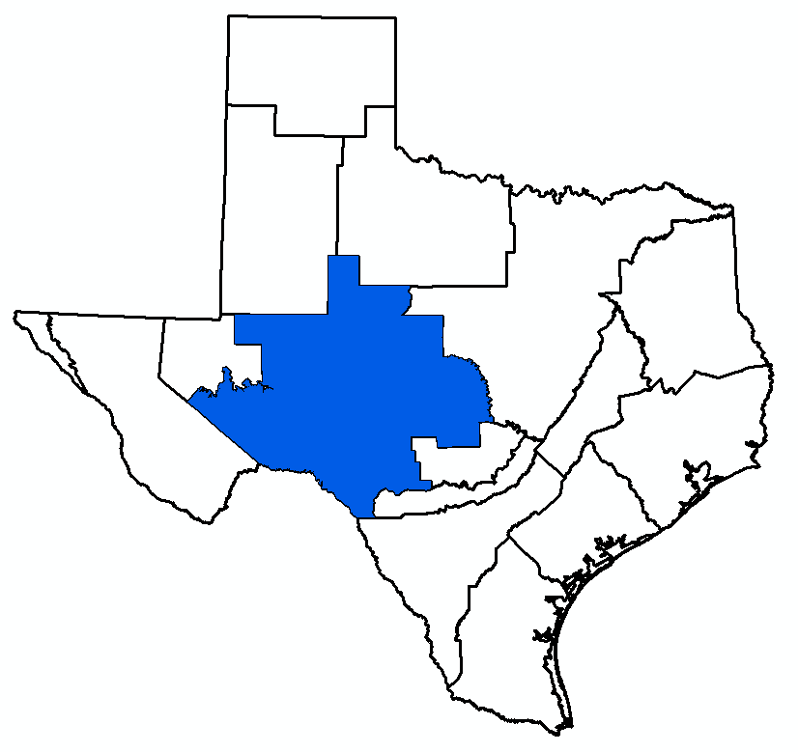
GMA 7 Joint Planning:
Comparison of Measured Drawdown and Simulated Drawdown from 2021 DFC Simulation
Bill Hutchison
GMA 7 Meeting
August 14, 2025

Slide 2
Outline
Review HB 2078
Average drawdown calculations
Review Aquifers/GAMs evaluated
Comparisons
  Capitan Reef Complex Aquifer
  Edwards-Trinity (Plateau), Pecos Valley, Trinity Aquifers
  High Plains Aquifer System
  Llano Uplift Aquifers
  Rustler Aquifer
Discussion/recommendation of how HB 2078 requirements will be handled in 2026 DFC
Workplan/Schedule/Budget

Slide 3
HB 2078 Amends Two Sections of Chapter 36
Management Plans (36.1071(e))
Joint Planning (36.108)
  Amends subsections (c) and (d-3)
  Adds subsections (c-1) and (d-1a)

Slide 4
New Management Plan Requirements
“Explanation in plain language”:
  How the district is monitoring and tracking the achievement of desired future conditions (DFCs)
  How the district has performed in achieving the desired future conditions (DFCs) over the preceding five-year joint planning cycle

Slide 5
New Joint Planning Requirements
Changes annual review of district management plans to “not less than once during each five-year period”
Part of the required management plan review: “the degree to which each district is achieving the desired future conditions established during the joint planning process through the implementation of the district’s management plan and rules”
Identify interim values for the desired future conditions (not to exceed 10 years) to assist the district monitoring interim progress in achieving desired future conditions (DFCs)
Include an explanation in plain language of why a desired future condition (DFC) was changed if the DFC is different from the DFC from the previous round
Include a summary of how each district is performing in achieving the desired future condition

Slide 6
Outline
Review HB 2078
Average drawdown calculations
Review Aquifers/GAMs evaluated
Comparisons
  Capitan Reef Complex Aquifer
  Edwards-Trinity (Plateau), Pecos Valley, Trinity Aquifers
  High Plains Aquifer System
  Llano Uplift Aquifers
  Rustler Aquifer
Discussion/recommendation of how HB 2078 requirements will be handled in 2026 DFC
Workplan/Schedule/Budget

Slide 7
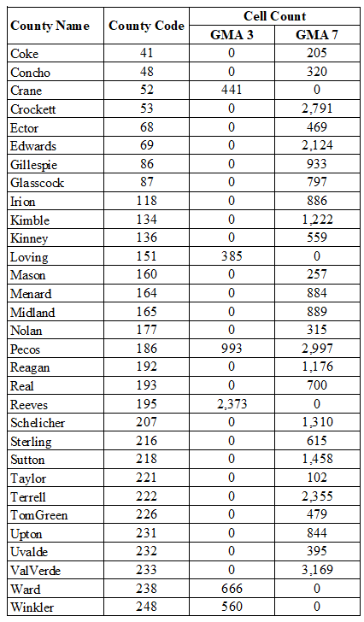
GAM Simulation Results and Average Drawdown (1)
Example: Edwards-Trinity (Plateau), Pecos Valley, and Trinity Aquifers
DFC simulation used the Alternative GAM (One-Layer Model)
Model domain is subdivided into “cells” (1 square mile)
  GMA 3 = 6,800 cells
  GMA 7 = 42,487 cells

Slide 8
GAM Simulation Results and Average Drawdown (2)
GAM results include groundwater elevation in each cell for each year of simulation
Drawdown (DD) = groundwater elevation in base year (GWE₂₀₁₂ ) minus groundwater elevation in year of interest (GWE_{yr})
  For DFC in 2070: DD = GWE₂₀₁₂ – GWE₂₀₇₀

Slide 9
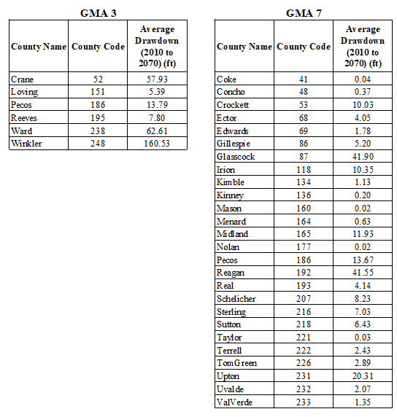
GAM Simulation Results and Average Drawdown (3)
Sum of drawdowns in each cell and divide by number of cells
2021 DFCs (Average Drawdown)

Slide 10
GAM Simulation Results and Average Drawdown (3)
Sum of drawdowns in each cell and divide by number of cells
2021 DFCs (Average Drawdown)

Slide 11
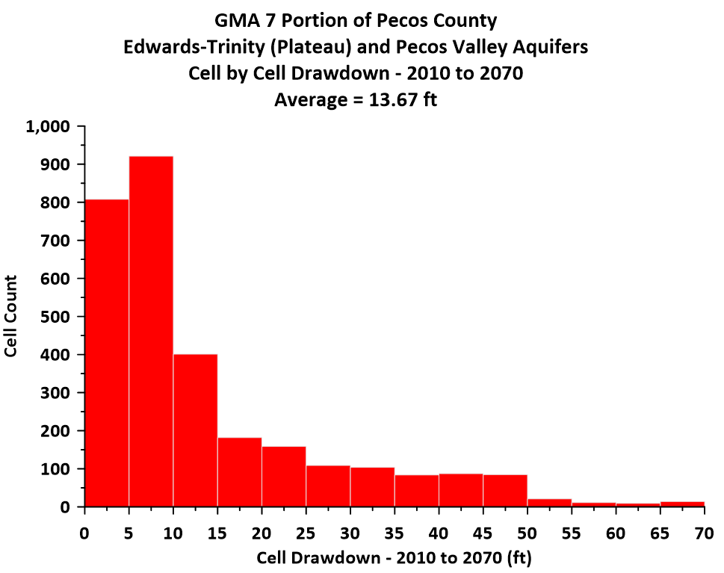
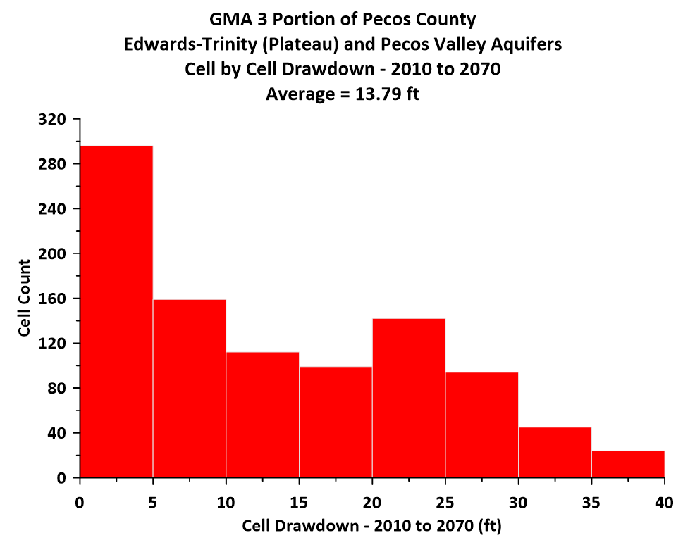
Variation of Drawdown (Pecos County Example)

Slide 12
Outline
Review HB 2078
Average drawdown calculations
Review Aquifers/GAMs evaluated
Comparisons
  Capitan Reef Complex Aquifer
  Edwards-Trinity (Plateau), Pecos Valley, Trinity Aquifers
  High Plains Aquifer System
  Llano Uplift Aquifers
  Rustler Aquifer
Discussion/recommendation of how HB 2078 requirements will be handled in 2026 DFC
Workplan/Schedule/Budget

Slide 13
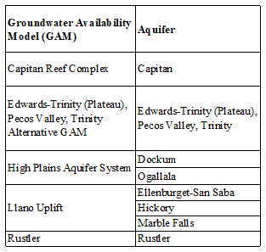
GAMs and Relevant Aquifers in GMA 7
5 GAMs
10 Relevant Aquifers

Slide 14
Subtasks to Complete Comparisons
Downloaded TWDB Groundwater Database on July 9, 2025
Identify wells with end-of-year data for baseline year
  Capitan = 2005
  ETP/PV = 2010 (except Kinney and Val Verde Counties)
  High Plains Aquifer System (Ogallala and Dockum) = 2012
  Llano Uplift Aquifers = 2010
  Rustler Aquifer = 2009
Locate each well on GAM grid (row and column)
Assign well to aquifer based on TWDB classification in database
Read post baseline data for each baseline well (calculate drawdown)
Extract groundwater elevations from DFC simulation at the locations and times for which actual drawdown are available (calculate drawdown)
Summarize results in figures and tables

Slide 15
Outline
Review HB 2078
Average drawdown calculations
Review Aquifers/GAMs evaluated
Comparisons
  Capitan Reef Complex Aquifer
  Edwards-Trinity (Plateau), Pecos Valley, Trinity Aquifers
  High Plains Aquifer System
  Llano Uplift Aquifers
  Rustler Aquifer
Discussion/recommendation of how HB 2078 requirements will be handled in 2026 DFC
Workplan/Schedule/Budget

Slide 16
Capitan Reef Complex Aquifer
Pecos County
  56 ft of drawdown (2006 to 2070)
  Should be 2005
Model calibration period ended in 2005
Searched TWDB groundwater database for groundwater elevations from October 2005 to March 2006
  No data (3 in April 2005, 1 in August 2005, none in 2006)
Recommend that Capitan Reef Complex be classified as not relevant for purposes of joint planning in GMA 7

Slide 17
Outline
Review HB 2078
Average drawdown calculations
Review Aquifers/GAMs evaluated
Comparisons
  Capitan Reef Complex Aquifer
  Edwards-Trinity (Plateau), Pecos Valley, Trinity Aquifers
  High Plains Aquifer System
  Llano Uplift Aquifers
  Rustler Aquifer
Discussion/recommendation of how HB 2078 requirements will be handled in 2026 DFC
Workplan/Schedule/Budget

Slide 18
Edwards-Trinity (Plateau), Pecos Valley, Trinity Aquifers
Grouped together because Alternative GAM is a one-layer model (lumped all aquifers together in a two-dimensional conceptualization)
  Alternative GAM completed in 2010 to address problems with official GAM
The DFC for most of GMA 7 is expressed as average drawdowns from 2010 to 2070 for each county
GMA 7 split out Kinney County and Val Verde County and developed DFCs with different models (spring flow DFCs)

Slide 19
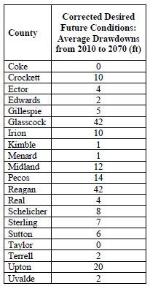
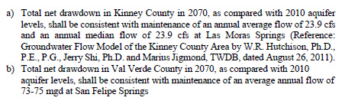
GMA 7 DFCs for Edwards-Trinity (Plateau), Pecos Valley, Trinity Aquifers
From GMA 7 Explanatory Report, August 28, 2021

Slide 20
Val Verde County
EcoKai report of 2014 (basis for DFC) documented the connection between Amistad Reservoir elevation and spring flow (San Felipe Creek flow)
  Model developed in 2014 report had monthly stress periods (June 1968 to August 2013)
San Felipe Creek flow and Amistad Reservoir elevation data downloaded from IBWC on July 26, 2025
Evaluation of Amistad Reservoir elevation vs. San Felipe Creek Flow

Slide 21
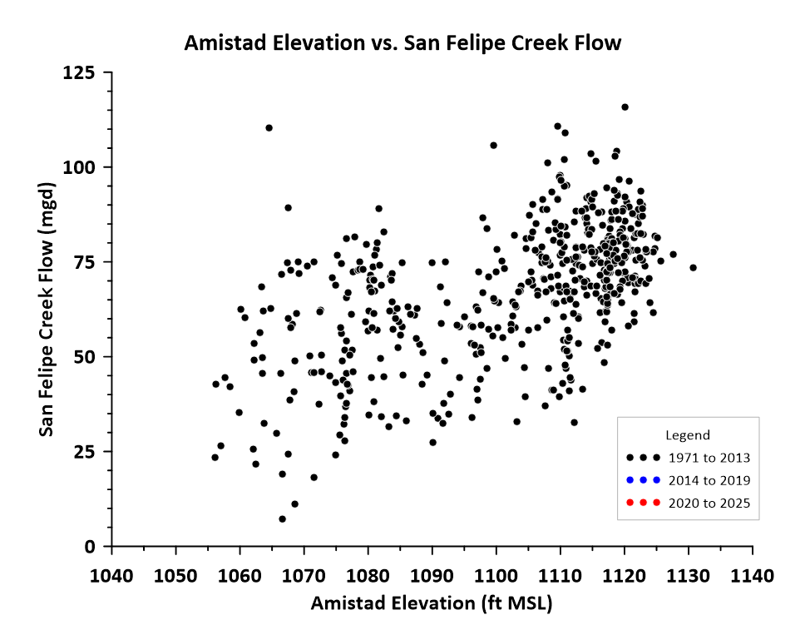

Slide 22
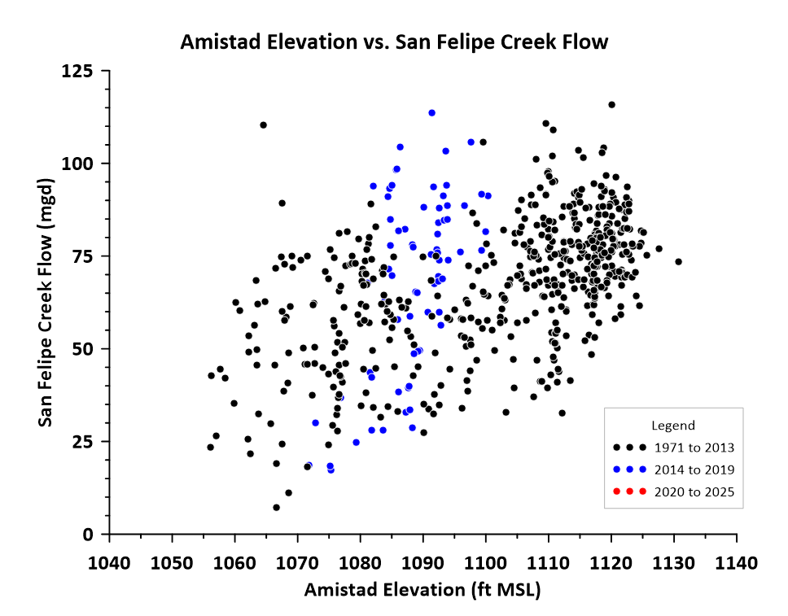

Slide 23
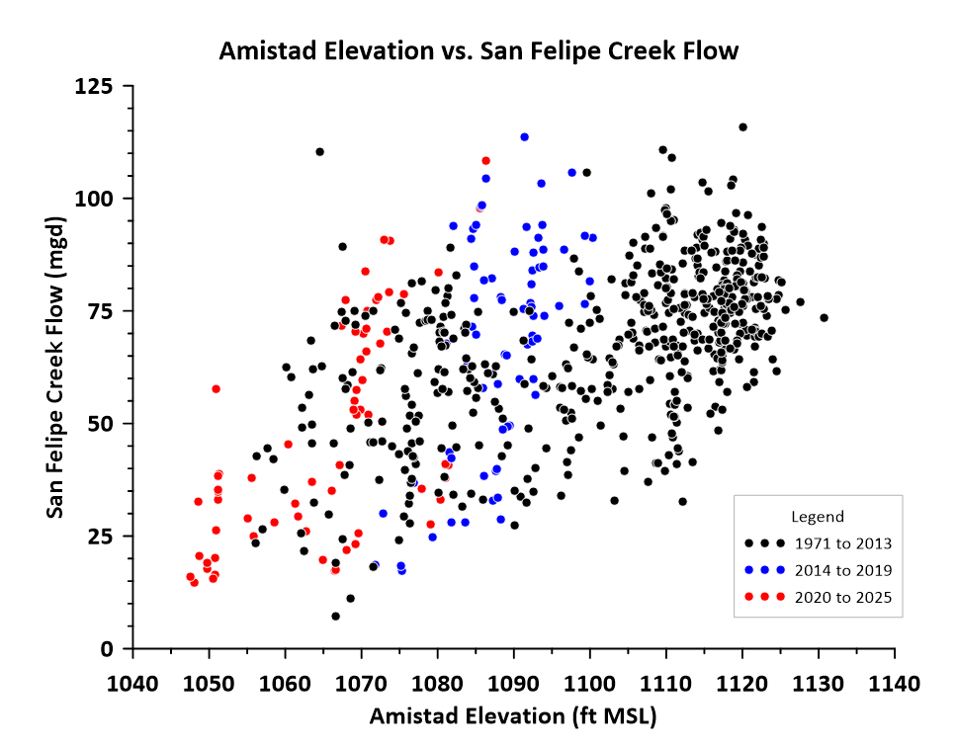

Slide 24
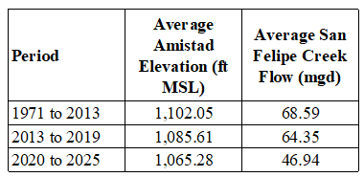
Averages for Each Period
Note non-linearity of spring flow decline:
  1971-2013 to 2013-2019:
    16 ft reservoir decline = 4 mgd spring decline
  2013-2019 to 2020-2025:
    20 ft reservoir decline = 17 mgd decline

Slide 25
Val Verde County Conclusions
Groundwater pumping has not increased recently
Recent spring flow decline is primarily due to lower reservoir levels (drought)
DFC was based on a simulation that assumed the 1971 to 2013 reservoir levels
  Since 2013, reservoir has been lower, therefore spring flow has been lower
No GCD in Val Verde County
Recommend that Val Verde County be classified as not relevant for purposes of joint planning

Slide 26
Kinney County
DFC expressed a goal to maintain historic spring flow (average of 23.9 cfs)
  Underlying assumption was that “current” pumping would result in “current” spring flow
Groundwater model that is basis for MAG was developed with “pumping” data provided by KCGCD to TWDB in 2010
  Permit totals were represented as actual pumping
  Initial DFC (2010) was adopted when Chapter 36 of Texas Water Code required districts to permit to the MAG
Disconnect between DFC and MAG was recognized in 2013
  Pumping at levels approaching MAG would result in not meeting the DFC
  KCGCD initiated a data collection program

Slide 27
Kinney County Data Collection Since 2013
Groundwater level instrumentation (now over 60 wells)
Rainfall gages (about 8 KCGCD and 8 TexMesoNet)
Satellite analysis of irrigation (1995 to 2023)
  Quality control of permit pumping reports
Detailed review of permit pumping reports and changes to procedures to receive pumping data from permittees
  Multi-year effort
  Identified erroneous meter reports and corrected
  Some data still missing

Slide 28
Kinney DFC Achievement
Methods to assess DFC annually have been documented since 2013 in KCGCD management plans
In 2014, spring flow gage was moved by USGS
Waited until 2022 to get reasonable amount of data in new gage to understand implications of changing gaging location
  Not a major issue due to wet conditions and relatively low pumping
2023 KCGCD Management Plan documented the updated method to assess DFC
Most recent DFC assessment = May 31, 2025

Slide 29
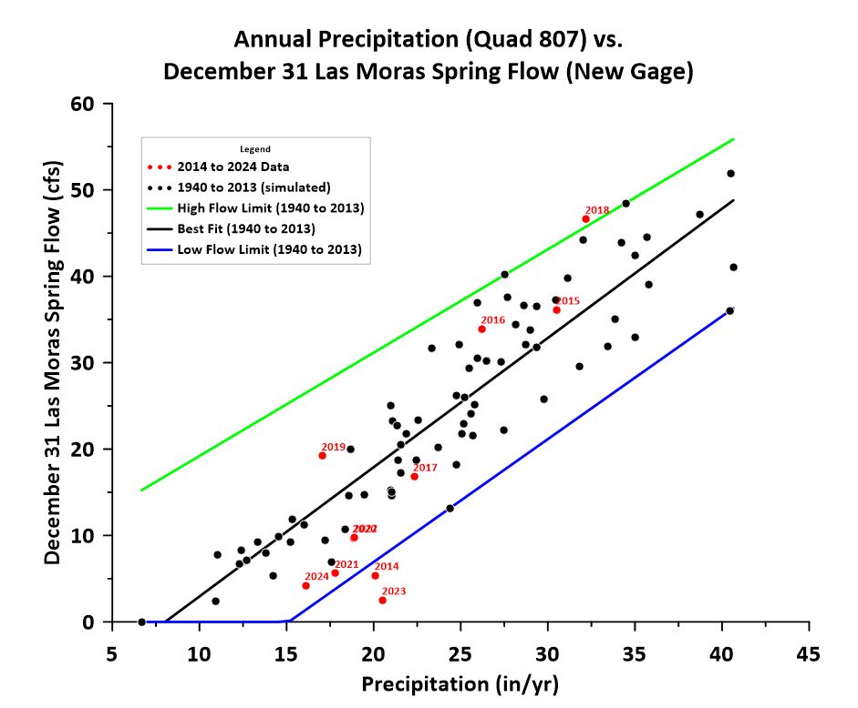
2024 Kinney DFC Letter Report
(May 31, 2025)
DFC not met in 2014
DFC met from 2015 to 2022
DFC not met in 2023
DFC met in 2024

Slide 30
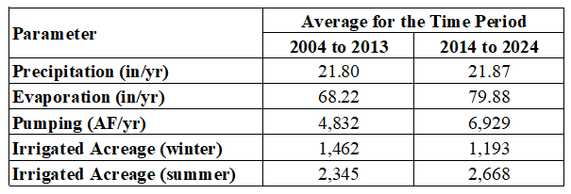
Analysis of 2023 and 2024
2024 represented the sixth consecutive year of below average precipitation
  Expect lower spring flow during drought periods
Irrigated acreage changes in recent years
  Slight increase in summer acreage and slight decrease in winter acreage (net water use increase)
Evaporation rates since 2020 have been highest on record (since 1954)
Observed pumping increase can be attributed to higher evaporation rate (peaked in 2022) and increase in summer irrigated acreage (precipitation the same)

Slide 31
Analysis of 2023 and 2024
2024 represented the sixth consecutive year of below average precipitation
  Expect lower spring flow during drought periods
Irrigated acreage changes in recent years
  Slight increase in summer acreage and slight decrease in winter acreage (net water use increase)
Evaporation rates since 2020 have been highest on record (since 1954)
Observed pumping increase can be attributed to higher evaporation rate (peaked in 2022) and increase in summer irrigated acreage (precipitation the same)

Slide 32
Analysis of 2023 and 2024
2024 represented the sixth consecutive year of below average precipitation
  Expect lower spring flow during drought periods
Irrigated acreage changes in recent years
  Slight increase in summer acreage and slight decrease in winter acreage (net water use increase)
Evaporation rates since 2020 have been highest on record (since 1954)
Observed pumping increase can be attributed to higher evaporation rate (peaked in 2022) and increase in summer irrigated acreage (precipitation the same)

Slide 33
Analysis of 2023 and 2024
2024 represented the sixth consecutive year of below average precipitation
  Expect lower spring flow during drought periods
Irrigated acreage changes in recent years
  Slight increase in summer acreage and slight decrease in winter acreage (net water use increase)
Evaporation rates since 2020 have been highest on record (since 1954)
Observed pumping increase can be attributed to higher evaporation rate (peaked in 2022) and increase in summer irrigated acreage (precipitation the same)

Slide 34
Analysis of 2023 and 2024
2024 represented the sixth consecutive year of below average precipitation
  Expect lower spring flow during drought periods
Irrigated acreage changes in recent years
  Slight increase in summer acreage and slight decrease in winter acreage (net water use increase)
Evaporation rates since 2020 have been highest on record (since 1954)
Observed pumping increase can be attributed to higher evaporation rate (peaked in 2022) and increase in summer irrigated acreage (precipitation the same)

Slide 35
MAG Issue
Current Kinney County MAG (GMA 7) = 70,329 AF/yr
Actual average pumping:
  2004 to 2013 = 4,832 AF/yr
  2014 to 2024 = 6,929 AF/yr
Pumping during recent drought (2020 to 2024):
  8,231 to 10,606 AF/yr
KCGCD consultants will provide analysis to update MAG
  Please recall that the official calculation of the MAG is a TWDB responsibility
GMA 7 will collaborate with KCGCD consultants to include updated MAG analysis in explanatory report

Slide 36
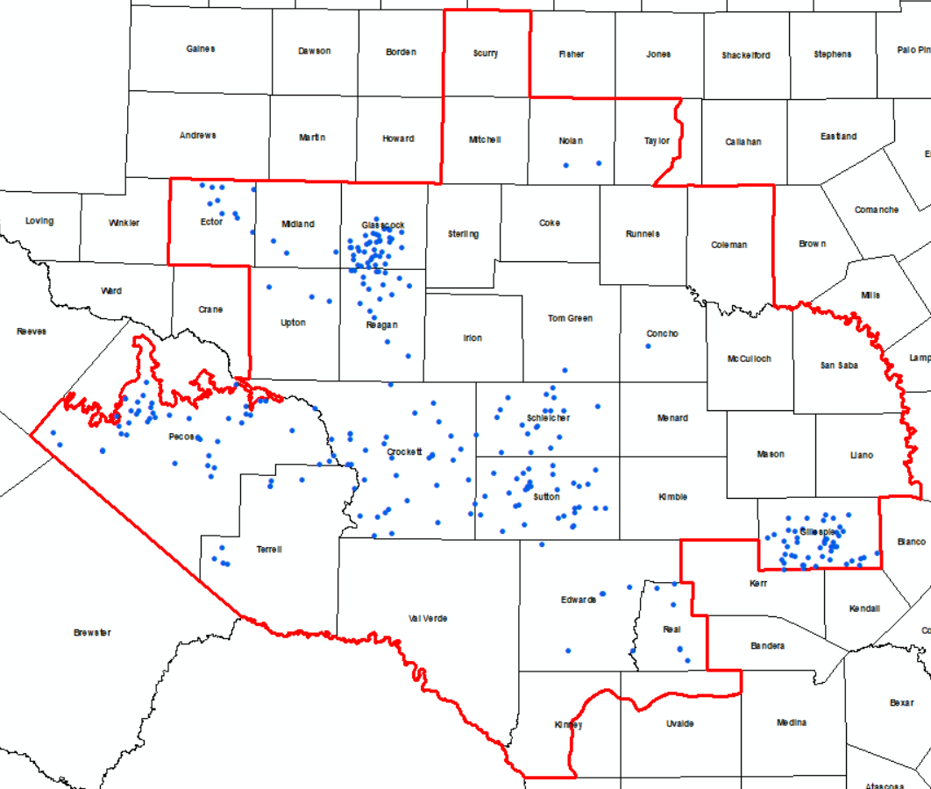
Rest of GMA 7 Portion of Edwards-Trinity (Plateau), Pecos Valley, Trinity Aquifers
Searched TWDB groundwater database for groundwater elevations from October 2010 to March 2011
280 Wells

Slide 37
Counties with DFCs and no Baseline Wells
Coke
Irion
Kimble
Menard
Sterling
Taylor
Uvalde

Slide 38
Actual Data vs. Interpolated/Extrapolated Data
This approach used actual data for baseline year (2010)
  Could be considered Phase 1 of this evaluation
Phase 2 of the evaluation could expand to include using wells with no 2010 measurement by interpolating or extrapolating groundwater elevations to estimate a “baseline” groundwater elevation
  Also, could use GCD data that has not been provided to TWDB
Please note that new GAM will have an updated calibration period
  Would likely result in a different baseline for DFC simulations in later rounds of joint planning
Proposed cost and schedule of Phase 2 will be presented below

Slide 39
Comparison Method
Calculate actual drawdown with measured data using 2010 baseline year
Calculate simulated drawdown at same locations and years using 2010 as the baseline year
Difference = Simulated Drawdown minus Actual Drawdown
  Positive = actual drawdown is less than simulated (good)
  Negative = actual drawdown is more than simulated (bad)
Plot individual points
  Actual Drawdown vs. Simulated Drawdown
  Frequency plot of differences
Tabulate averages by County

Slide 40
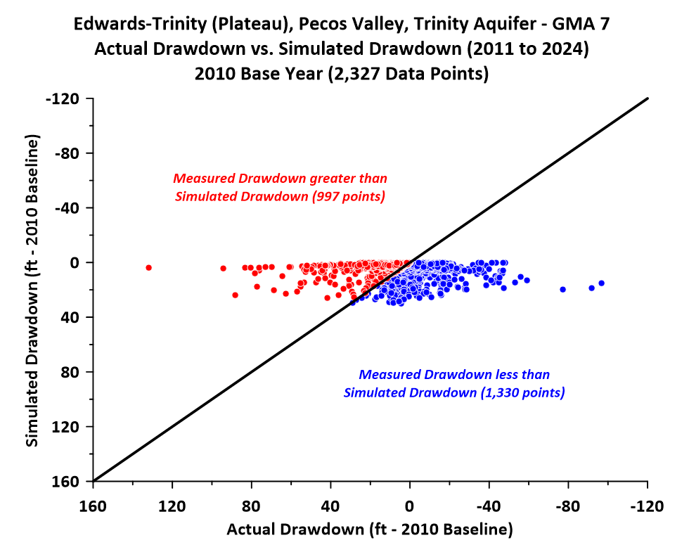
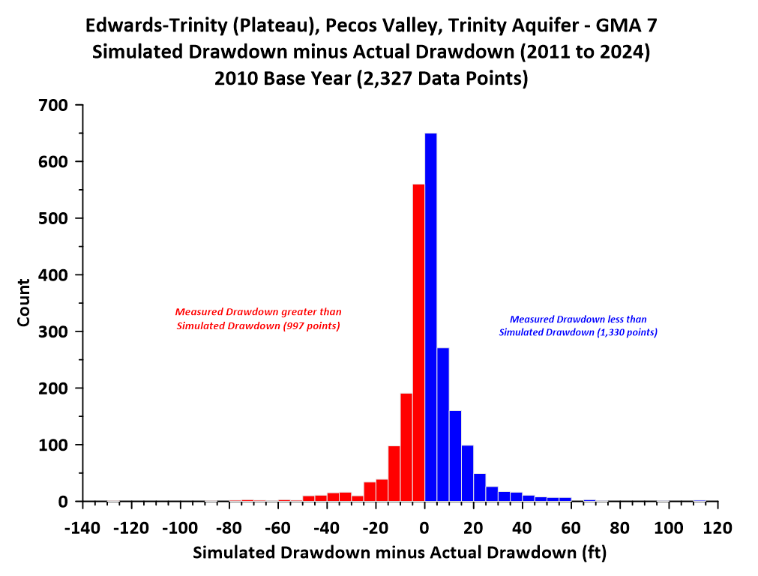
Results (Graphs)

Slide 41
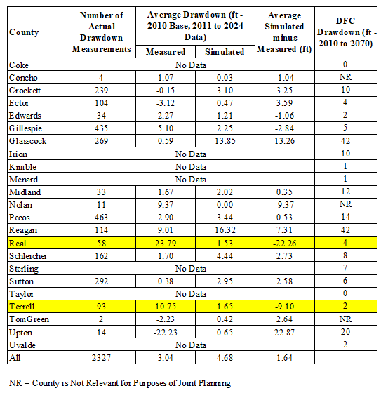
Results (Tabular)
Highlighted Counties represent model issues
Also identified in Reeves County (GMA 3)
  Work to update Alternative GAM has started and will include Real and Terrell counties
  Discussed with TWDB (documentation standards for acceptance)

Slide 42
Real and Terrell Counties
Real County
  Average actual drawdown = 24 ft
  Average simulated drawdown = 2 ft
  MAG = 7,523 AF/yr
  2023 Pumping Estimate (TWDB) = 711 AF/yr
Terrell County
  Average actual drawdown = 11 ft
  Average simulated drawdown = 2 ft
  MAG = 1,420 AF/yr
  2023 Pumping Estimate (TWDB) = 553 AF/yr
Signals that transmissivity in model needs adjustment
  Similar to issue in Reeves County (GMA 3)

Slide 43
Conclusions
Overall actual drawdown data are consistent with DFC
  Exceptions (Real and Terrell) are the result of model problems that will be addressed with recommended update
  Nolan and Concho are “negative”, but are classified as not relevant for purposes of joint planning (no DFC)
  Only other differences that are negative are Edwards and Gillespie
    Difference is less than 3 feet
    It is likely that a more thorough analysis would show that drought conditions are the explanation
Recommend Phase 2 (interpolation and extrapolation or GCD data to obtain baseline groundwater elevations) if GMA 7 wants to fully evaluate county by county comparison

Slide 44
Outline
Review HB 2078
Average drawdown calculations
Review Aquifers/GAMs evaluated
Comparisons
  Capitan Reef Complex Aquifer
  Edwards-Trinity (Plateau), Pecos Valley, Trinity Aquifers
  High Plains Aquifer System
  Llano Uplift Aquifers
  Rustler Aquifer
Discussion/recommendation of how HB 2078 requirements will be handled in 2026 DFC
Workplan/Schedule/Budget

Slide 45
High Plains Aquifer System GAM
Dockum Aquifer
Ogallala Aquifer

Slide 46
Dockum Aquifer
DFCs (average drawdown from 2010 to 2070)
  Pecos County: 52 ft
  Reagan County: 14 ft
Model calibration period ended in 2012
Please note:
  Explanatory report and Tech Memo 16-01 use 2012 as baseline year
  GMA 7 resolution lists 2010 as baseline year
  TWDB official summary also uses 2010 as baseline year
Searched TWDB groundwater database for groundwater elevations from October 2012 to March 2013
  26 wells (none in Pecos or Reagan Counties)

Slide 47
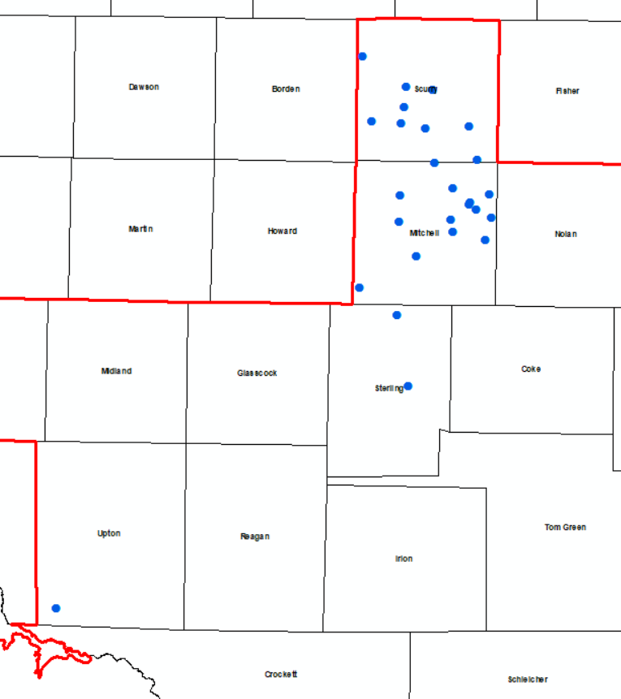
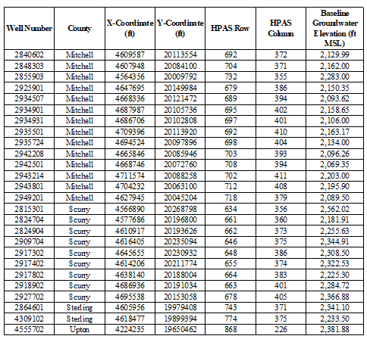
Dockum Baseline Wells

Slide 48
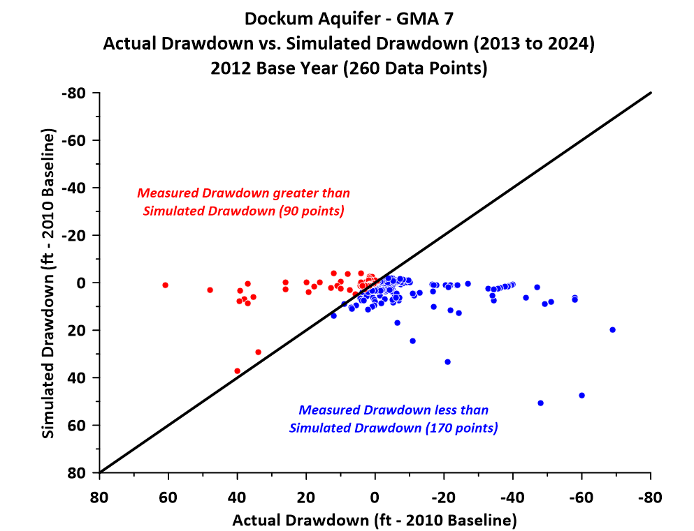
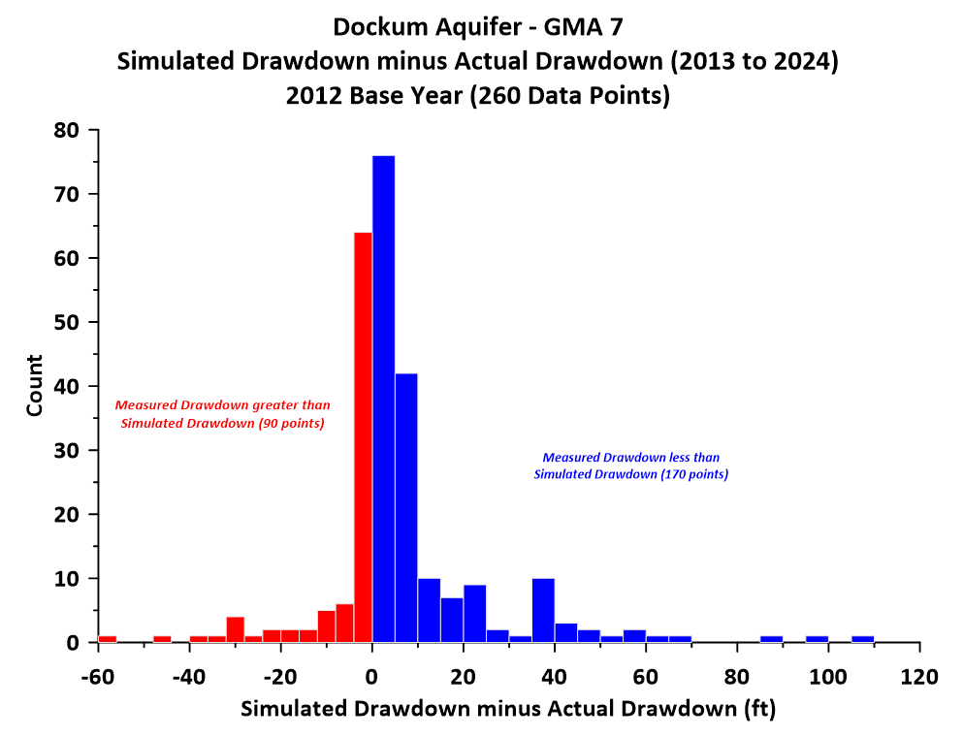
Dockum Aquifer Comparison Results

Slide 49
Conclusions
Overall actual drawdown data are consistent with GAM simulation
However, the areas covered in the analysis are not relevant for purposes of joint planning (no DFC)
Recommend that the Dockum Aquifer be classified as not relevant for purposes of joint planning in GMA 7

Slide 50
Ogallala Aquifer
DFCs (average drawdown from 2010 to 2070)
  Glasscock County: 6 feet
Model calibration period ended in 2012
Please note:
  Explanatory report and Tech Memo 16-01 use 2012 as baseline year
  GMA 7 resolution lists 2010 as baseline year
  TWDB official summary also uses 2010 as baseline year
Searched TWDB groundwater database for groundwater elevations from October 2012 to March 2013
  12 wells (all in Midland County)
  There were wells with data in Glasscock County with a 2010 baseline

Slide 51
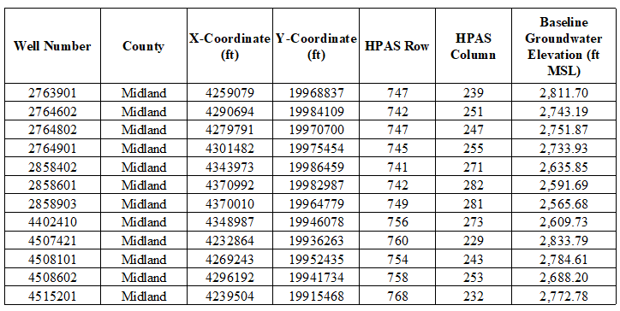
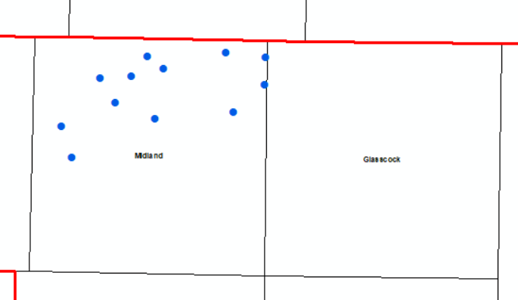
Ogallala Baseline Wells

Slide 52
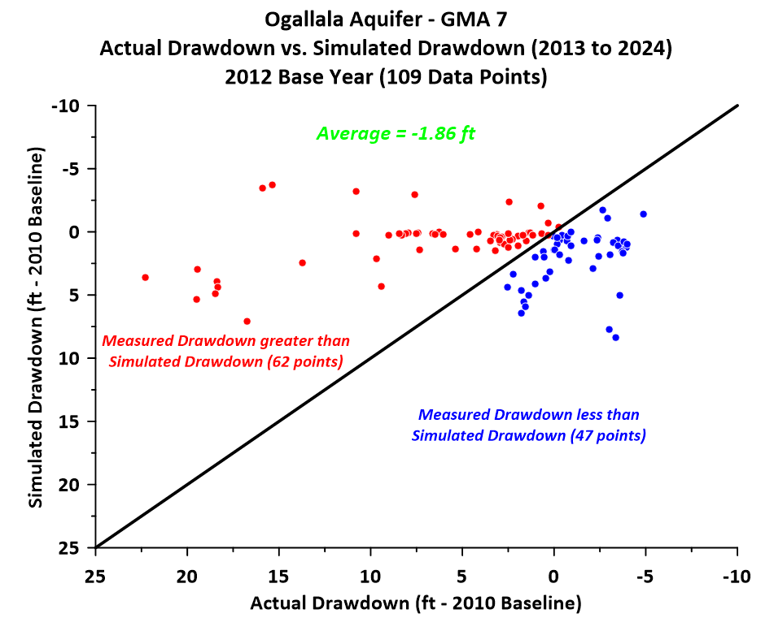
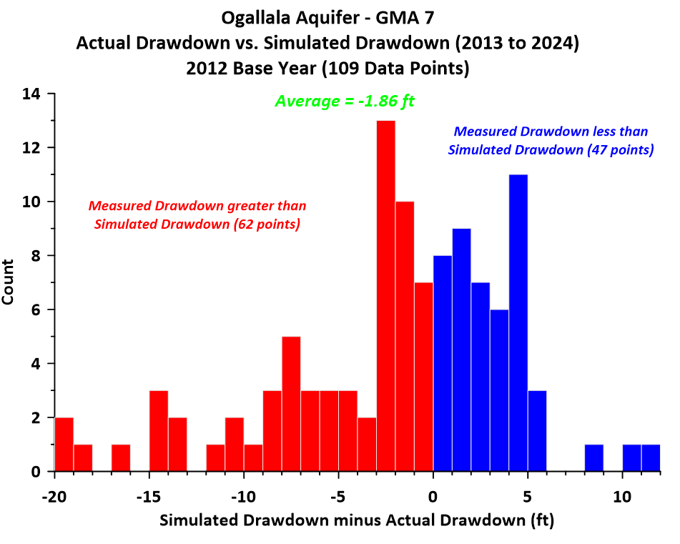
Ogallala Aquifer Comparison Results

Slide 53
Conclusions
Comparison is limited to Midland County (no GCD and classified as not relevant for purposes of joint planning, so no DFC)
Email from Rhetta Hector (7/29/2025)
  Glasscock GCD Board has decided to request classification of Ogallala Aquifer not relevant for purposes of joint planning
Recommend classifying Ogallala as not relevant for purposes of joint planning in GMA 7

Slide 54
Outline
Review HB 2078
Average drawdown calculations
Review Aquifers/GAMs evaluated
Comparisons
  Capitan Reef Complex Aquifer
  Edwards-Trinity (Plateau), Pecos Valley, Trinity Aquifers
  High Plains Aquifer System
  Llano Uplift Aquifers
  Rustler Aquifer
Discussion/recommendation of how HB 2078 requirements will be handled in 2026 DFC
Workplan/Schedule/Budget

Slide 55
Llano Uplift Aquifer System GAM
Marble Falls Aquifer (Layer 3)
Ellenburger-San Saba Aquifer (Layer 5)
Hickory Aquifer (Layer 7)

Slide 56
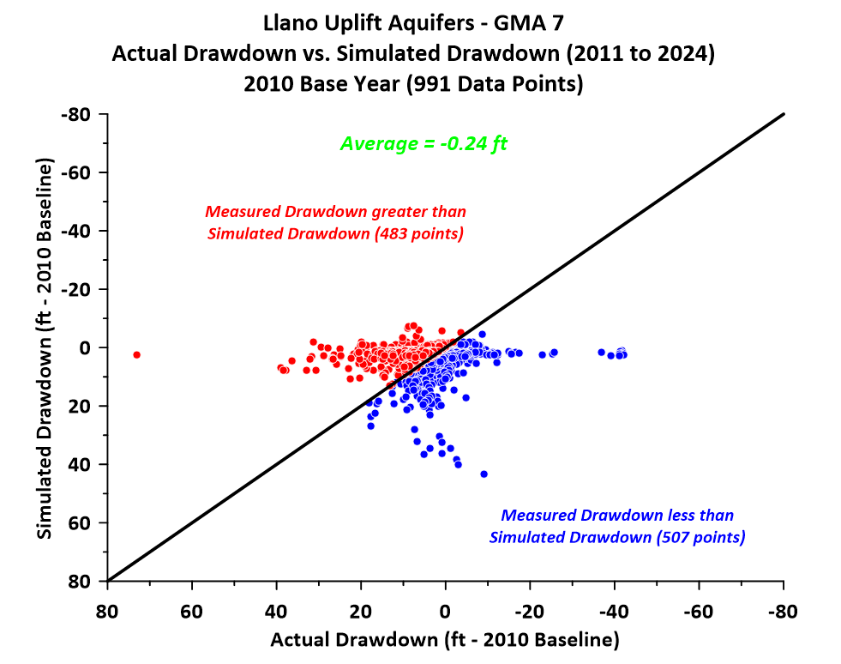
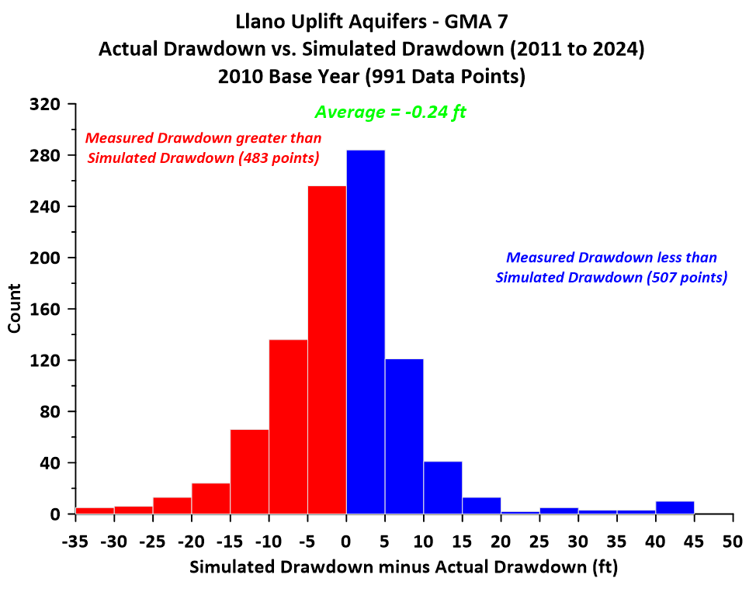
Results (Graphs)

Slide 57
Marble Falls Aquifer
Classified as not relevant for purposes of joint planning in GMA 7 (No DFCs)
Model calibration period ended in 2010
Searched TWDB groundwater database for groundwater elevations from October 2010 to March 2011
  5 wells

Slide 58
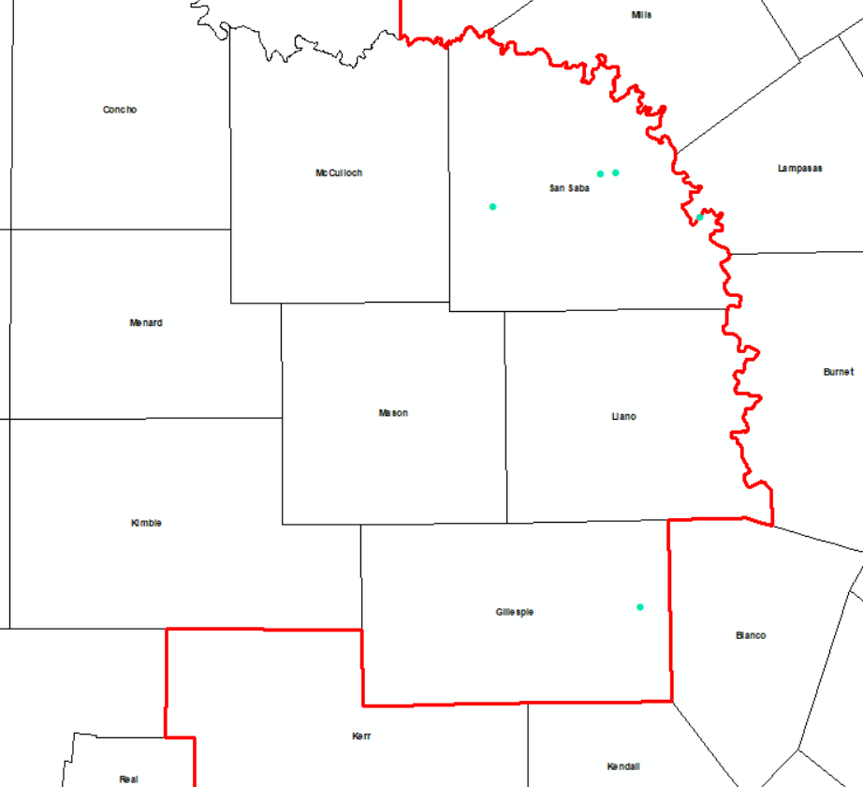
Marble Falls Baseline Wells
Gillespie = 1 well
San Saba = 4 wells

Slide 59
Marble Falls Results
One well in Gillespie County had post-baseline data (11 data points)
  5 baseline wells
Average Actual Drawdown = 16 ft
Average Simulated Drawdown = 8 ft
Difference (Simulated minus Actual) = - 8 ft
No DFC (not relevant for purposes of joint planning)
Likely a drought issue

Slide 60
Ellenburger-San Saba Aquifer
DFC (Average drawdown from 2010 to 2070)
  Gillespie = 8 ft
  Kimble = 18 ft
  Mason = 14 ft
  McCulloch = 29 ft
  Menard = 46 ft
  San Saba = 5 ft
Model calibration period ended in 2010
Searched TWDB groundwater database for groundwater elevations from October 2010 to March 2011
  57 wells

Slide 61
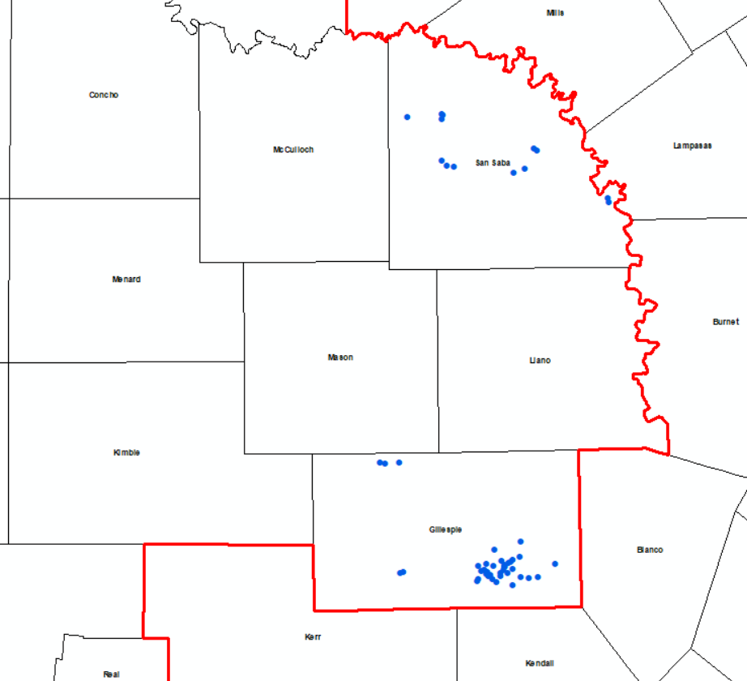
Ellenburger-San Saba Aquifer Baseline Wells
Gillespie = 44 wells
Kimble = 0 wells
Mason = 0 wells
McCulloch = 0 wells
Menard = 0 wells
San Saba =13 wells

Slide 62
Ellenburger-San Saba Results
43 wells had post-baseline data (429 data points)
  57 baseline wells
  All in Gillespie County
Average Actual Drawdown = 5 ft
Average Simulated Drawdown = 2 ft
Difference (Simulated minus Actual) = - 3 ft
Likely a drought issue
No data for other counties with DFC
  Phase 2 (interpolation and extrapolation or GCD data for baseline estimates)

Slide 63
Hickory Aquifer
DFC (Average drawdown from 2010 to 2070)
  Concho = 53 ft
  Gillespie = 9 ft
  Kimble = 18 ft
  Mason = 17 ft
  McCulloch = 29 ft
  Menard = 46 ft
  San Saba = 6 ft
Model calibration period ended in 2010
Searched TWDB groundwater database for groundwater elevations from October 2010 to March 2011
  76 wells

Slide 64
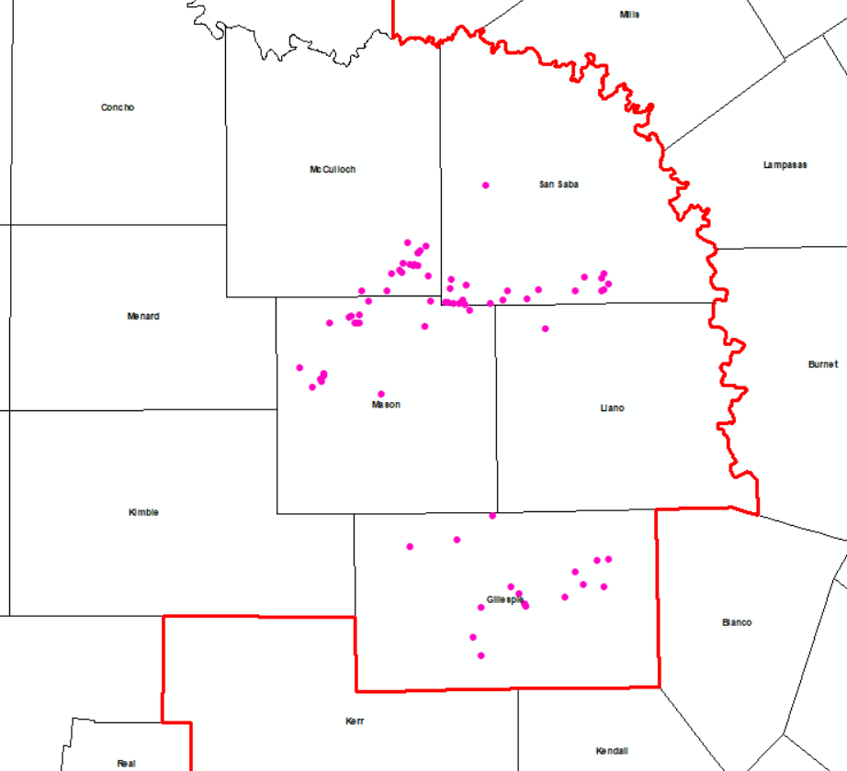
Hickory Aquifer Baseline Wells
Concho = 0 wells
Gillespie = 17 wells
Kimble = 0 wells
Llano = 1 wells
  No DFC (not relevant)
Mason = 20 wells
McCulloch = 16 wells
Menard = 0 wells
San Saba = 22 wells

Slide 65
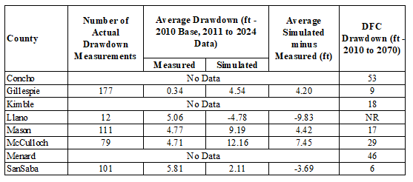
Hickory Results
68 wells had post-baseline data (480 data points)
  76 baseline wells
Average Actual Drawdown = 3 ft
Average Simulated Drawdown = 6 ft
Difference (Simulated minus Actual) = 3 ft
No data for other counties with DFC
  Phase 2 (interpolation and extrapolation or GCD data for baseline estimates)

Slide 66
Conclusions
Marble Falls Aquifer
  Currently not relevant for purposes of joint planning
  Recommend continuing this classification
Ellenburger-San Saba Aquifer
  Small “negative” value in Gillespie County (drought?)
  Other counties with DFC and no baseline data (Kimble, Mason, McCulloch, and Menard) need a Phase 2 to estimate baseline groundwater elevations to complete comparison
Hickory Aquifer
  Gillespie, Mason, and McCulloch all meeting DFC
  Llano (not relevant and no GCD) and San Saba have “negative” differences (drought?)
  Concho, Kimble, and Menard need a Phase 2 to estimate baseline groundwater elevations to complete comparison

Slide 67
Outline
Review HB 2078
Average drawdown calculations
Review Aquifers/GAMs evaluated
Comparisons
  Capitan Reef Complex Aquifer
  Edwards-Trinity (Plateau), Pecos Valley, Trinity Aquifers
  High Plains Aquifer System
  Llano Uplift Aquifers
  Rustler Aquifer
Discussion/recommendation of how HB 2078 requirements will be handled in 2026 DFC
Workplan/Schedule/Budget

Slide 68
Rustler Aquifer
DFC (Average drawdown from 2009 to 2070)
  Pecos = 94 ft
Model calibration period ended in 2009
Searched TWDB groundwater database for groundwater elevations from October 2009 to March 2010
  1 well (Pecos County)

Slide 69
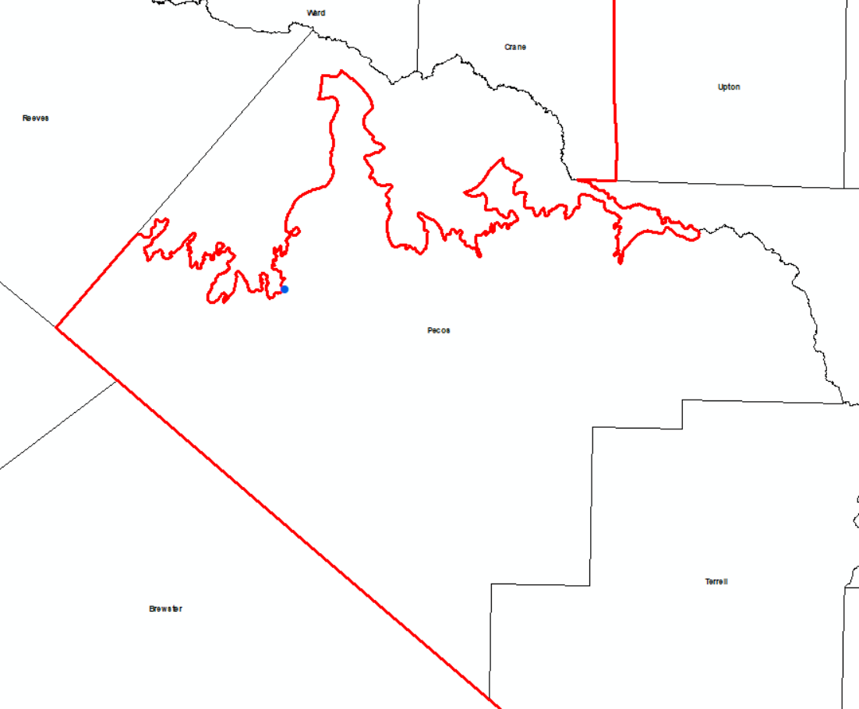
Rustler Well Location in Pecos County

Slide 70
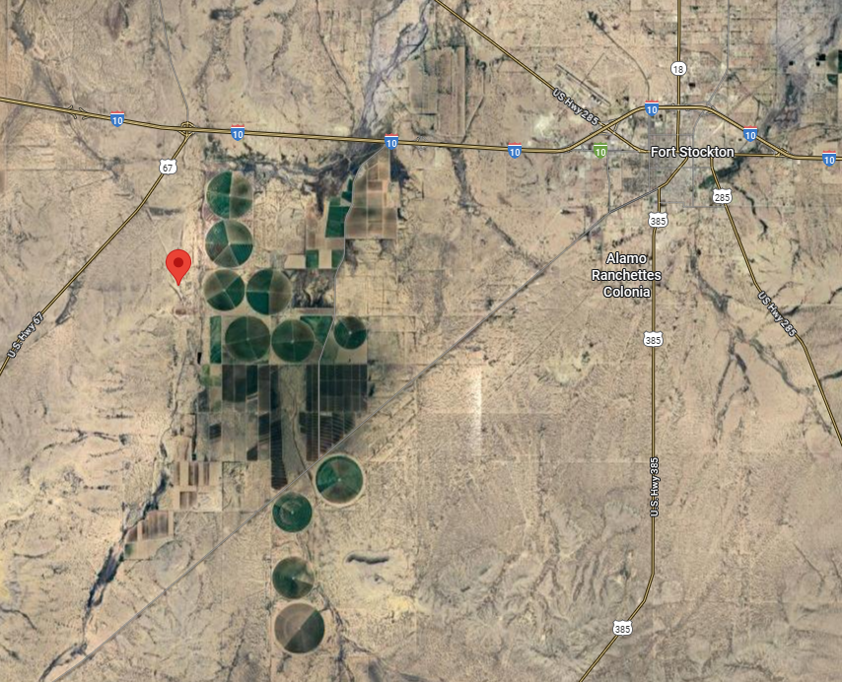
Rustler Well Location on Google Map
Just west of irrigated area (Leon-Belding)
Some Rustler pumping for irrigation in area
Impact of pumping in overlying Edward-Trinity (Plateau) also possible

Slide 71
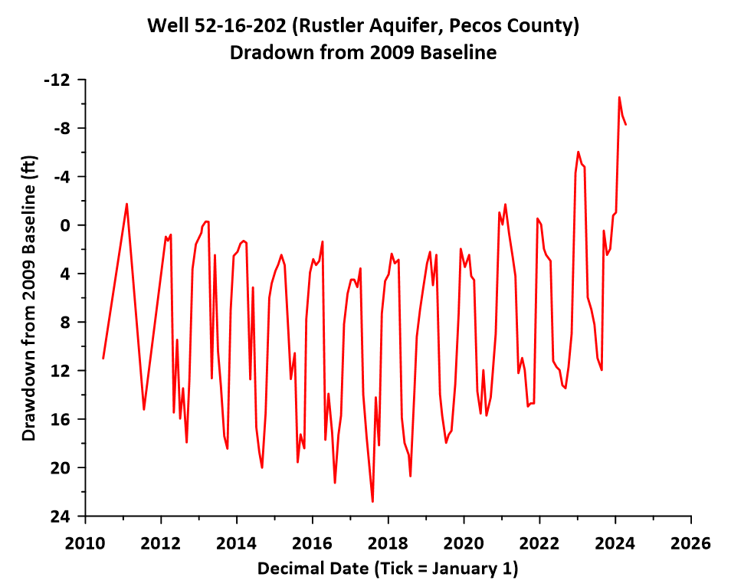
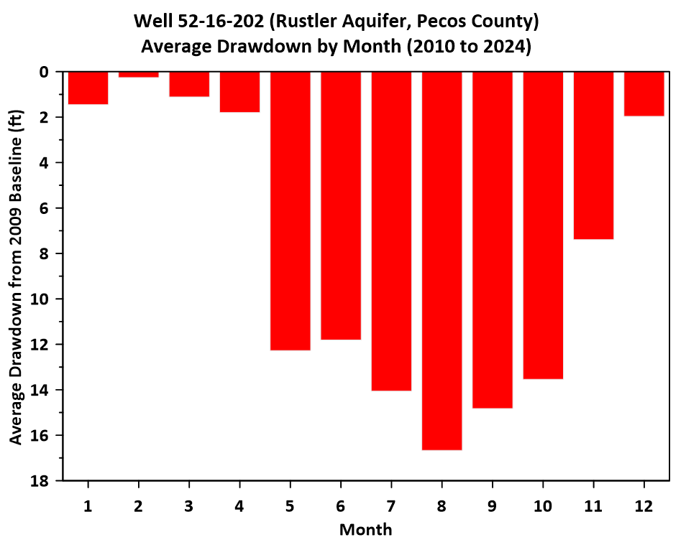
Rustler Well Actual Drawdown (Full Hydrograph)

Slide 72
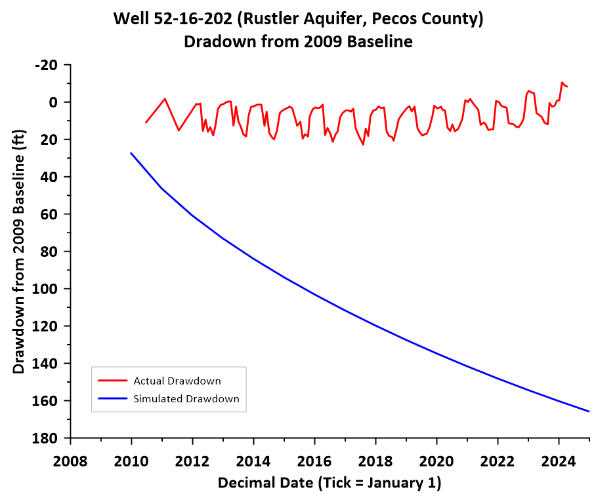
Comparison of Actual and Simulated Drawdown (Full Hydrograph)

Slide 73
Conclusions (1)
Hydrograph of well looks like other Leon-Belding wells
  Need to verify TWDB classification as a Rustler well
Actual drawdown is less than simulated drawdown
TM 15-06 noted that in GMA 7 portion of Pecos County:
  Average simulated drawdown (DFC) = 94 ft (2009 to 2070)
  Maximum simulated drawdown = 405 ft (2009 to 2070)
Simulated drawdown in 2070 at this location = 278 ft

Slide 74
Conclusions (2)
Rustler GAM has severe limitations as a predictive model
  GHBs in layer 1 of model (“all overlying formations”)
  As documented in Tech Memo 15-06, assumptions must be made for predictive simulations regarding head declines in overlying formations
  Assumption associated GHB decline with DFC simulation (0.5 ft/yr) may be too high
With a single well and a GAM that is not useful, recommend that Rustler Aquifer be classified as not relevant for purposes of joint planning
  Revisit recommendation during 5th round of joint planning when Pecos County local model is completed

Slide 75
Outline
Review HB 2078
Average drawdown calculations
Review Aquifers/GAMs evaluated
Comparisons
  Capitan Reef Complex Aquifer
  Edwards-Trinity (Plateau), Pecos Valley, Trinity Aquifers
  High Plains Aquifer System
  Llano Uplift Aquifers
  Rustler Aquifer
Discussion/recommendation of how HB 2078 requirements will be handled in 2026 DFC
Workplan/Schedule/Budget

Slide 76
HB 2078 Requirements and 2026 DFC
Law takes effect September 1, 2025
  TWDB administrative rules would follow (early 2026?)
Explanatory reports are “due” after adoption of DFC (deadline = January 5, 2027)
Specific requirements may not be known by time of proposed DFC (and draft explanatory report)
  Please recall that a draft explanatory report is not required in statute
Results of DFC Comparison will be documented in Tech Memo and referenced in explanatory report
  May need to be edited or enhanced depending on TWDB administrative rules

Slide 77
Summary of Recommendations (1)
Capitan Reef Complex Aquifer
  Recommend classification as not relevant for purposes of joint planning
Edwards-Trinity (Plateau), Pecos Valley, and Trinity Aquifers
  Recommend Phase 2 of DFC comparison for counties with no TWDB baseline wells
  Recommend update of Alternative GAM
  Recommend update of MAG approach for Kinney County
  Recommend classification of Val Verde County as not relevant for purposes of joint planning

Slide 78
Summary of Recommendations (2)
High Plains Aquifer System
  Dockum and Ogallala Aquifers: recommend classification as not relevant for purposes of joint planning
Llano Uplift Aquifers
  Marble Falls Aquifer: recommend keeping classification as not relevant for purposes of joint planning
  Ellenburger-San Saba and Hickory Aquifers: Phase 2 of DFC comparison for counties with no TWDB baseline wells
Rustler Aquifer
  Recommend classification as not relevant for purposes of joint planning

Slide 79
Outline
Review HB 2078
Average drawdown calculations
Review Aquifers/GAMs evaluated
Comparisons
  Capitan Reef Complex Aquifer
  Edwards-Trinity (Plateau), Pecos Valley, Trinity Aquifers
  High Plains Aquifer System
  Llano Uplift Aquifers
  Rustler Aquifer
Discussion/recommendation of how HB 2078 requirements will be handled in 2026 DFC
Workplan/Schedule/Budget

Slide 80
Workplan/Schedule/Budget
Review past invoices for 4th round of joint planning
Review proposed budget and assumptions related to recommended budget
Review proposed schedule of meetings

Slide 81
Past Invoices for 4th Round of Joint Planning
Invoice 1: $7,500 (October 20, 2022)
  Review TWDB recharge and pumping reports, 10/22/2025 GMA 7 meeting
Invoice 2: $4,000 (February 25, 2025)
  Updated GAM meetings with TWDB, 2/19/2025 joint GMA 3 and GMA 7 meeting
Invoice 3: $2,500 (April 10, 2025)
  4/10/2025 GMA 7 meeting
Total = $14,000

Slide 82
Proposed Budget Assumptions
Capitan Reef Complex, Dockum, Ogallala, and Rustler are not relevant for purposes of joint planning
  Only two GAMs and two explanatory reports plus not relevant documentation
Phase 2 of the DFC Comparison is completed
Alternative GAM (one-layer model) is updated
Four GAM runs are needed for DFC development
  Any combination for the two GAMs (2 and 2, 3 and 1, or 1 and 3)

Slide 83
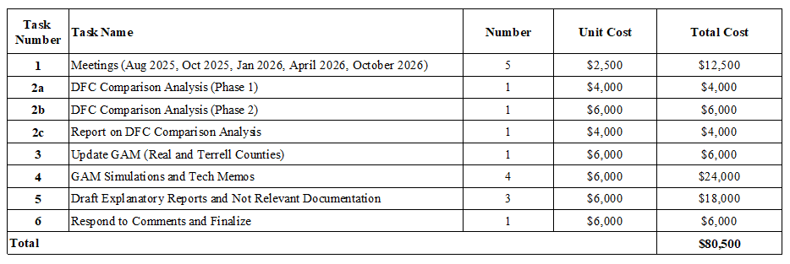
Proposed Budget

Slide 84
Proposed Meeting Schedule
August 14, 2025 (today)
  Phase 1 of DFC Comparison
October 2025:
  Phase 2 of DFC Comparison
  Alternative GAM update
  Initial GAM simulations
January 2026: Updated GAM simulations (as directed from October 2025 meeting), Draft Explanatory Reports (includes 9 factors discussion), and not relevant documentation
April 2026: Updates based on input/discussion from January 2026 meeting (i.e. updated draft explanatory report), vote on proposed DFCs
October 2026: Review public comments, proposed responses, draft final Explanatory Reports, vote on final DFCs

Slide 85
Budget Planning
Invoice 4 - Today: $6,500
Invoice 5 - October 2025: $30,500
Invoice 6 - January 2026: $32,500
Invoice 7 - April 2026: $2,500
Invoice 8 - October 2026: $8,500
Total: $80,500

Slide 86
Questions/Discussion
Bill Hutchison billhutch@texasgw.com

