Slide 1
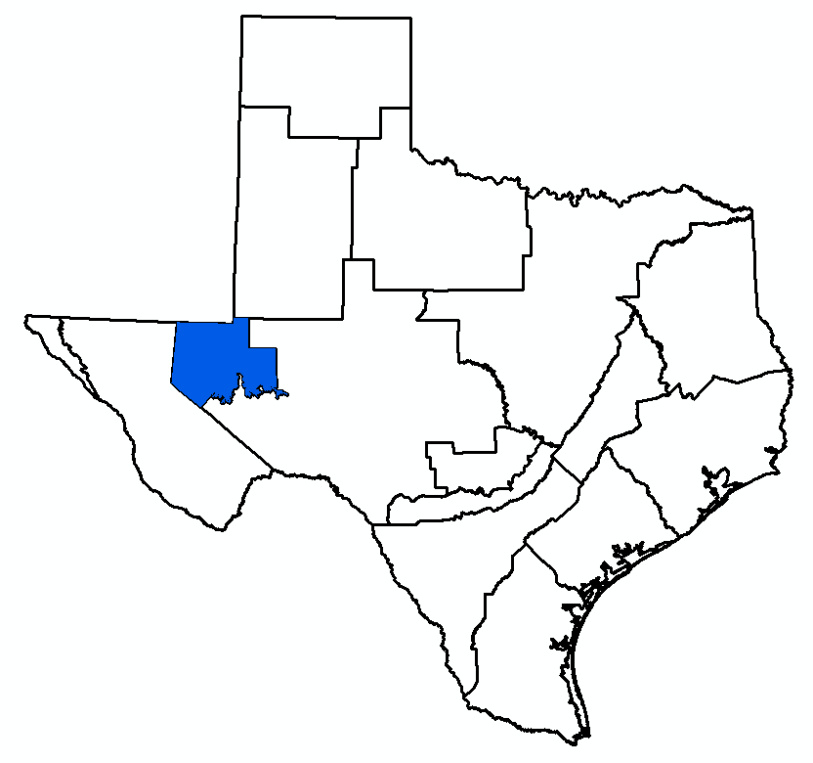
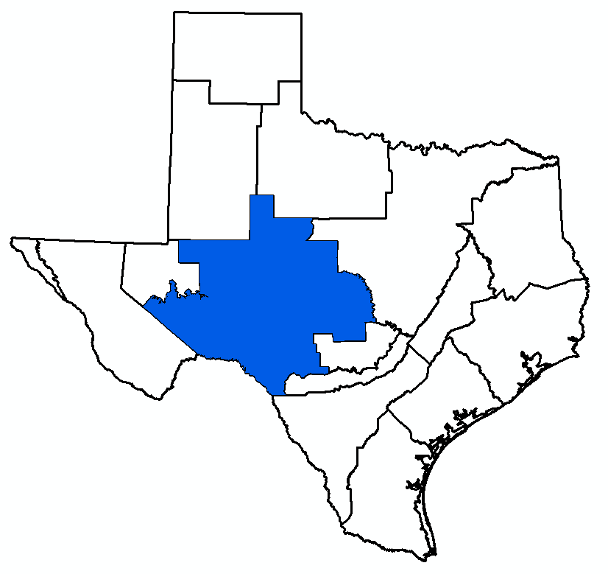
Agenda Item 6: DFC Comparison Updated Calibration of Alternative GAM Updated GAM Simulations Draft Explanatory Reports and Non-Relevant Documentation
Bill Hutchison
GMA 3 and 7 Joint Meeting
April 23, 2026

Slide 2
Topics
DFC Comparison
Updated Calibration of Alternative GAM
Updated GAM Simulations
Draft Explanatory Report and Non-Relevant Documentation

Slide 3
Topics
DFC Comparison
Updated Calibration of Alternative GAM
Updated GAM Simulations
Draft Explanatory Report and Non-Relevant Documentation

Slide 4
DFC Comparison (GMA 3)
Complete
GMA 3 Technical Memorandum 25-01 (Draft - September 5, 2025)
Presented results at GMA 3 meeting on October 22, 2025
Summary of Findings:
Capitan Reef Complex Aquifer
Recommended classification as not relevant for purposes of joint planning
Dockum Aquifer
Recommended classification as not relevant for purposes of joint planning
Edwards-Trinity (Plateau) and Pecos Valley Aquifers
Recommended update to Alternative GAM calibration (Pecos and Reeves counties)
Rustler Aquifer
Recommended classification as not relevant for purposes of joint planning

Slide 5
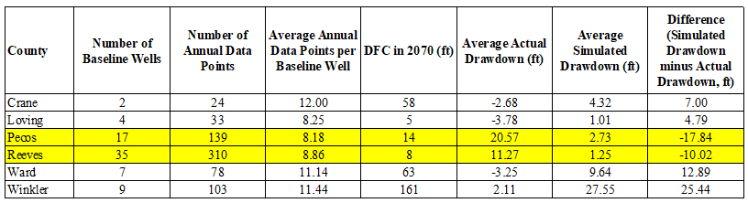
GMA 3 DFC Comparison

Slide 6
DFC Comparison (Phase 1 - GMA 7) (1)
Presented at GMA 7 meeting of August 14, 2025
Summary of Findings
Capitan Reef Complex Aquifer
Recommended classification as not relevant for purposes of joint planning
Edwards-Trinity (Plateau), Pecos Valley, and Trinity Aquifers
Recommended Phase 2 (GCD data and interpolated baselines)
Recommended update of Alternative GAM
Recommended update of MAG approach for Kinney County
Recommended classification of Val Verde County as not relevant for purposes of joint planning

Slide 7
DFC Comparison (Phase 1 - GMA 7) (2)
Presented at GMA 7 meeting of August 14, 2025
Summary of Findings
High Plains Aquifer System (Dockum and Ogallala Aquifers)
Recommended classification as not relevant for purposes of joint planning
Llano Uplift Aquifers
Marble Falls Aquifer: recommended keeping classification as not relevant for purposes of joint planning
Ellenburger-San Saba and Hickory Aquifers: recommended Phase 2 (GCD data and interpolated baselines)
Rustler Aquifer
Recommended classification as not relevant for purposes of joint planning

Slide 8
DFC Comparison (Phase 2 – GMA 7)
Complete
GMA 7 Technical Memorandum 26-01 (Draft – April 16, 2026)
Initial work presented at GMA 7 meeting of November 6, 2025
Updated with GCD data (Irion and Sterling counties)
Work on Edwards-Trinity (Plateau), Pecos Valley, and Trinity Aquifers complete
Updated with GCD data (Irion and Sterling counties – 11/6/2025 GMA 7 meeting)
Updated with baseline interpolations (TWDB data) – 3/18/2026 GMA 7 meeting
Work on Llano Uplift (Hickory) complete
Updated with baseline interpolations (TWDB data)
No additional data from Hickory Aquifer available (City of San Angelo)

Slide 9
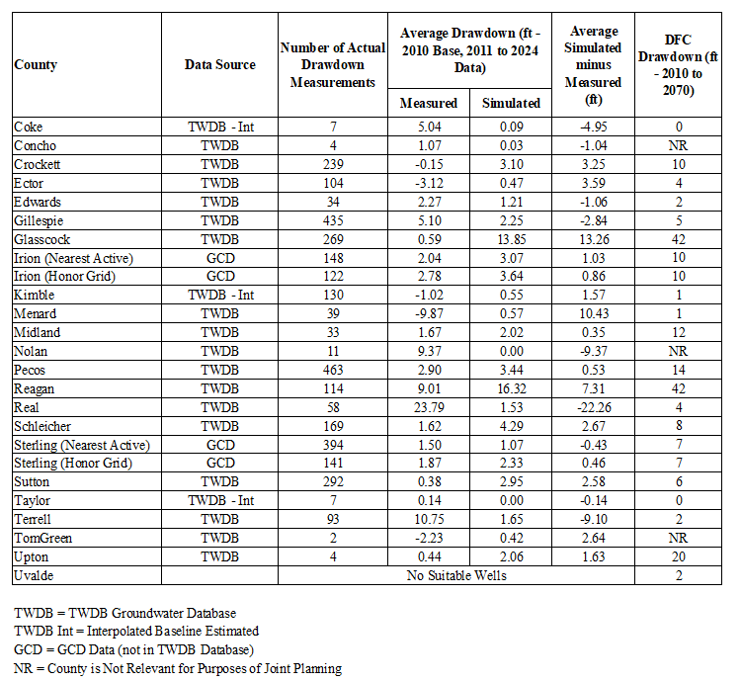
Drawdown Comparison:
Edwards-Trinity (Plateau), Pecos Valley, Trinity Aquifers

Slide 10
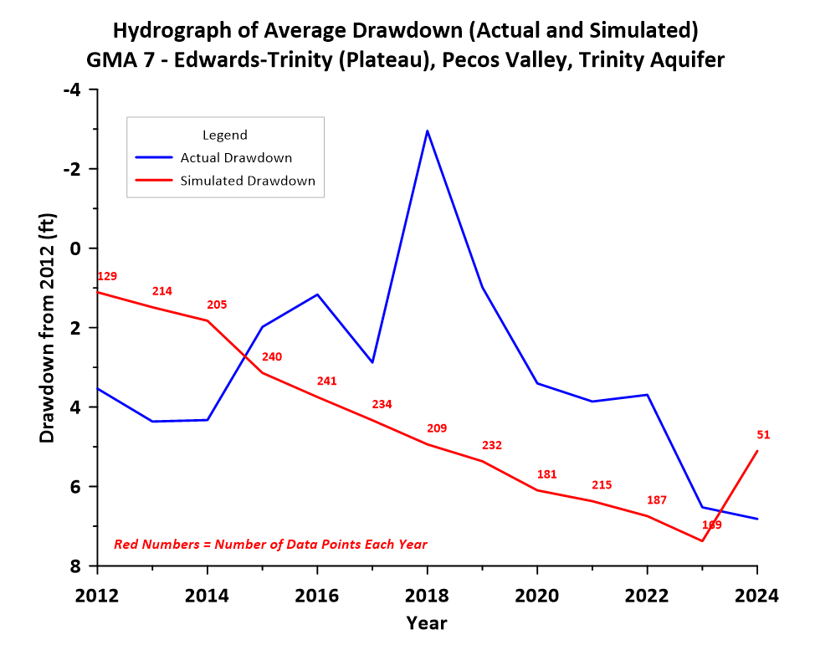

Slide 11
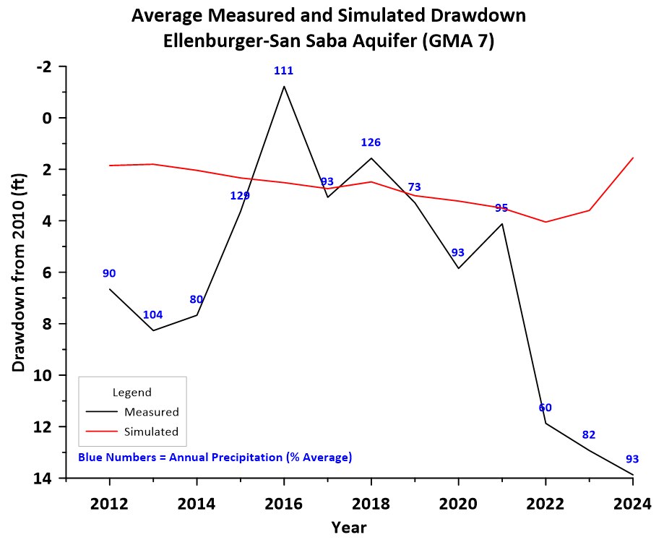
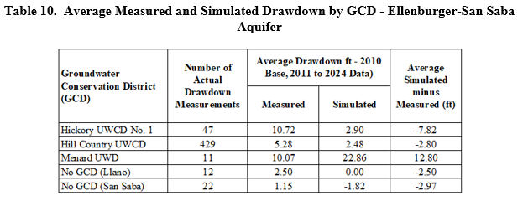

Slide 12
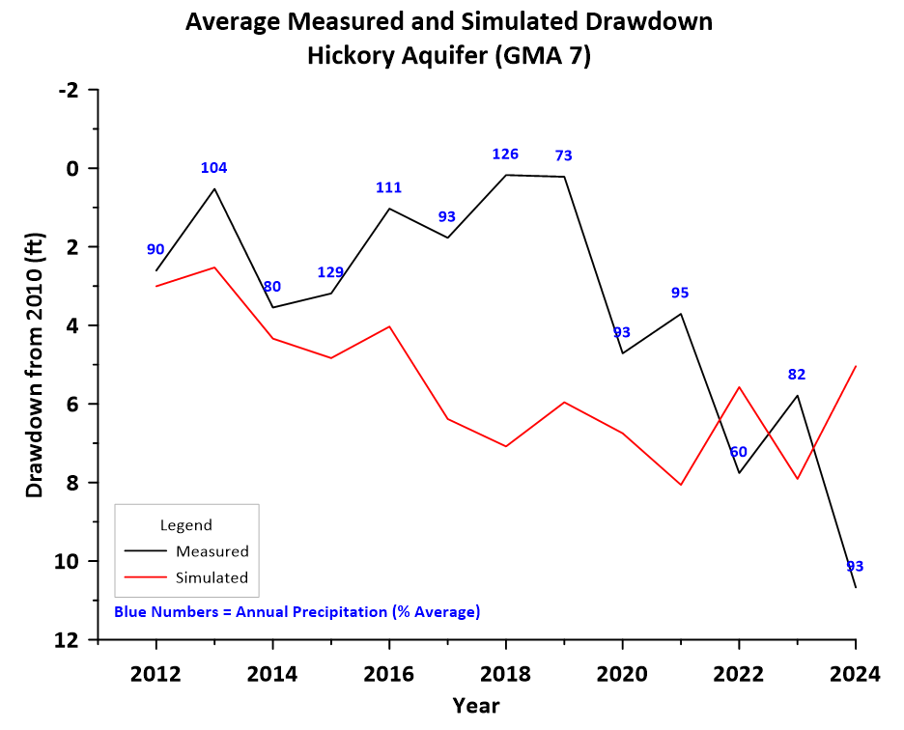
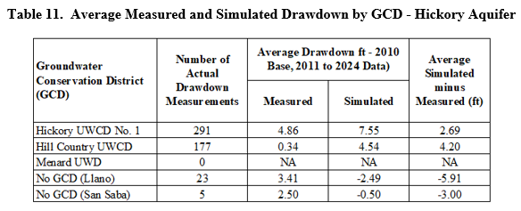

Slide 13
Topics
DFC Comparison
Updated Calibration of Alternative GAM
Updated GAM Simulations
Draft Explanatory Report and Non-Relevant Documentation

Slide 14
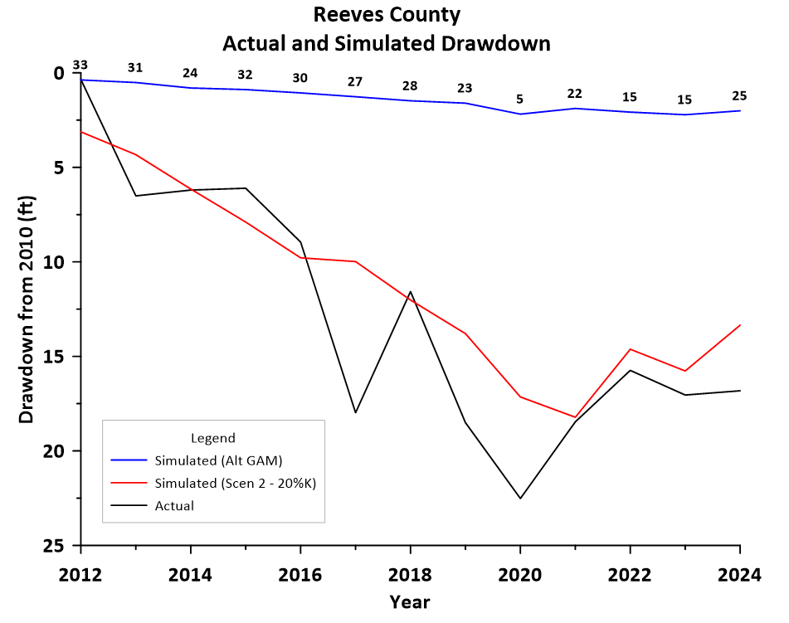
Updated Calibration of Alternative GAM (GMA 3 and GMA 7)
Complete
Documentation Report (April 16, 2026)

Slide 15
Topics
DFC Comparison
Updated Calibration of Alternative GAM
Updated GAM Simulations
Draft Explanatory Report and Non-Relevant Documentation

Slide 16
Updated GAM Simulations (Llano Uplift GAM - GMA 7)
Based on input received in 2016
Essentially no increase in pumping from calibration period
Scenario 26.1 completed
TM 26-02 – April 17, 2026
Same input pumping as past rounds of joint planning
Simulation extended to 2080

Slide 17
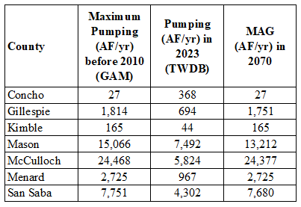
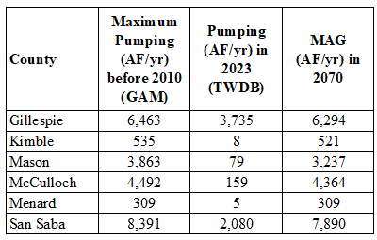
Past Pumping and Current MAG (Previously Presented at Meeting of March 18, 2026)
Hickory Aquifer
Ellenburger-San Saba Aquifer

Slide 18
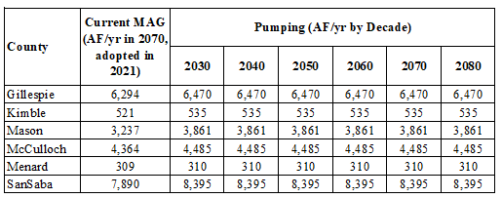
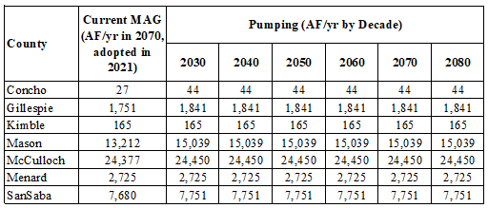
Scenario 26.1 Llano Uplift GAM Pumping
Ellenburger-San Saba Aquifer
Hickory Aquifer

Slide 19
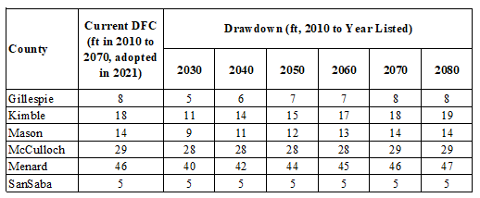
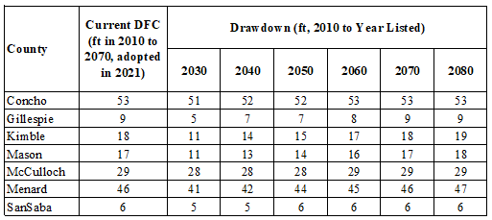
Scenario 26.1 Llano Uplift GAM Average Drawdown
Ellenburger-San Saba Aquifer
Hickory Aquifer

Slide 20
Updated GAM Simulations (ETP - GMA 3 and GMA 7)
Updated Alternative GAM (Edwards-Trinity (Plateau), Pecos Valley, and Trinity Aquifers)
Three “initial” scenarios
Scenario 26.1 (same pumping as last round of joint planning)
Scenario 26.2 (Schleicher County pumping = 15,640 AF/yr)
Scenario 26.3 (Schleicher County pumping = 17,254 AF/yr)
Set up to run more scenarios today

Slide 21
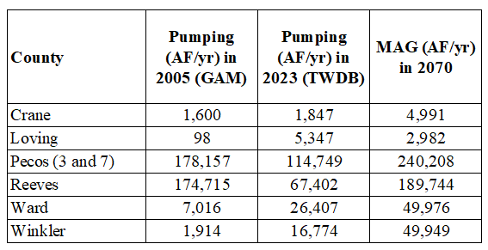
Edwards-Trinity (Plateau) and Pecos Valley Aquifers –
All Counties (GMA 3)
Previously Presented at Meeting of March 18, 2026

Slide 22
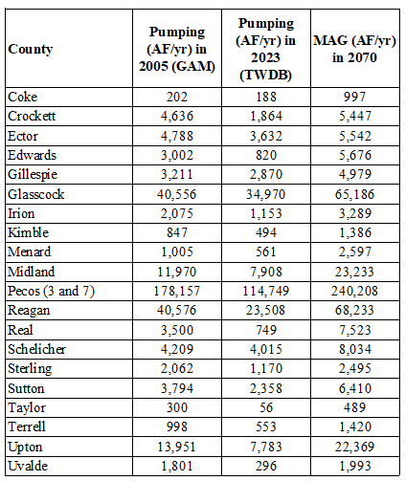
Edwards-Trinity (Plateau), Pecos Valley, and Trinity Aquifers –
Relevant Counties (GMA 7)
Previously Presented at Meeting of March 18, 2026

Slide 23
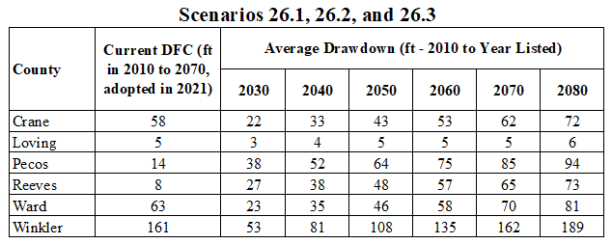
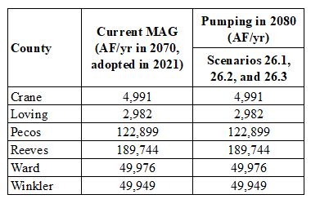
GMA 3 Results Tech Memo 26-01 (April 18, 2026)
Average Drawdown
Pumping

Slide 24
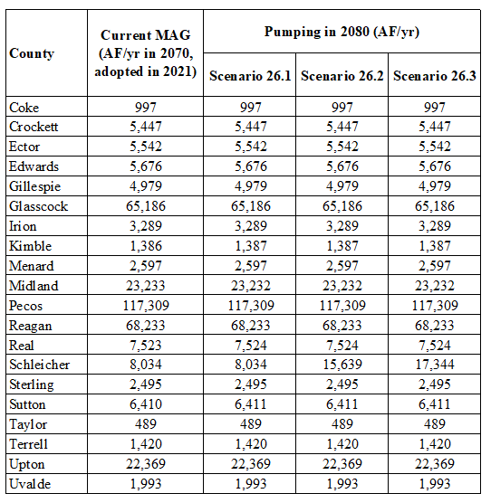
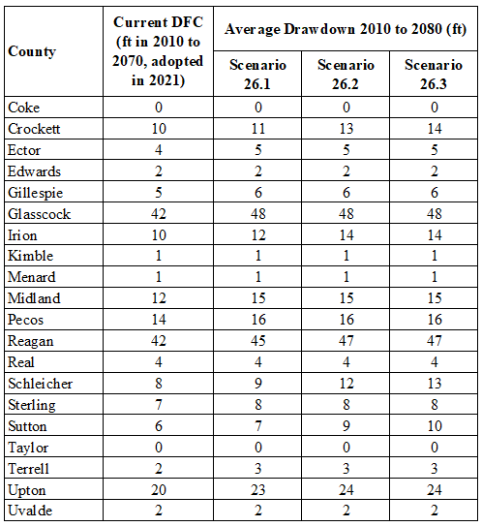
GMA 7 Results Tech Memo 26-03 (April 18, 2026)
Pumping
Average Drawdown
Note: Decadal Average Drawdown included in TM 26-03 (HB 2078 Requirement)

Slide 25
Topics
DFC Comparison
Updated Calibration of Alternative GAM
Updated GAM Simulations
Draft Explanatory Report and Non-Relevant Documentation

Slide 26
Draft Explanatory Reports
GMA 3
Edwards-Trinity (Plateau) and Pecos Valley Aquifers
GMA 7
Edwards-Trinity (Plateau), Pecos Valley, and Trinity Aquifers
Llano Uplift Aquifers
To be completed once a proposed DFC is adopted
Statute does not require them until end of process
To be completed by end of June

Slide 27
Non-Relevant Documentation – GMA 3
Existing documentation for:
Igneous Aquifer
Ogallala Aquifer
New documentation for:
Capitan Reef Complex Aquifer
Dockum Aquifer
Rustler Aquifer
To be completed by end of June

Slide 28
Non-Relevant Documentation – GMA 7
Existing documentation for:
Blaine Aquifer
Cross Timbers Aquifer
Igneous Aquifer
Lipan Aquifer
Seymour Aquifer
New documentation for:
Capitan Reef Complex Aquifer
Dockum Aquifer
Ogallala Aquifer
Rustler Aquifer
To be completed by end of June

Slide 29
Workplan/Schedule/Budget
GMA 3 Budget and Invoice
GMA 7 Budget and Invoice

Slide 30
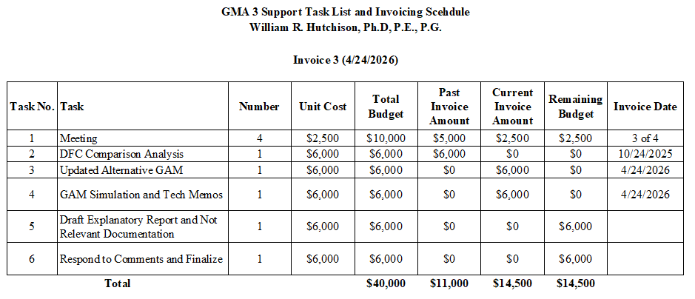
Current Budget Progress (GMA 3)

Slide 31
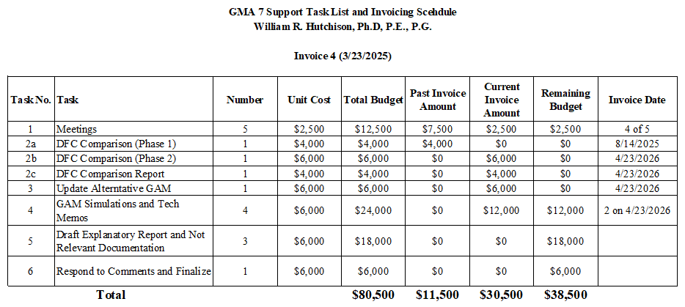
Current Budget Progress (GMA 7)

Slide 32
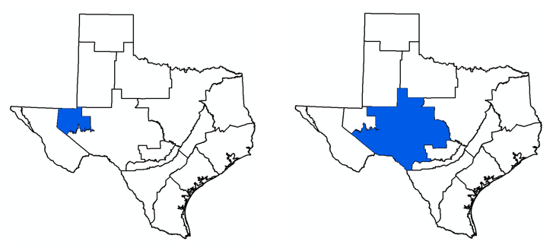
Questions/Discussion Bill Hutchison billhutch@texasgw.com

