Slide 1
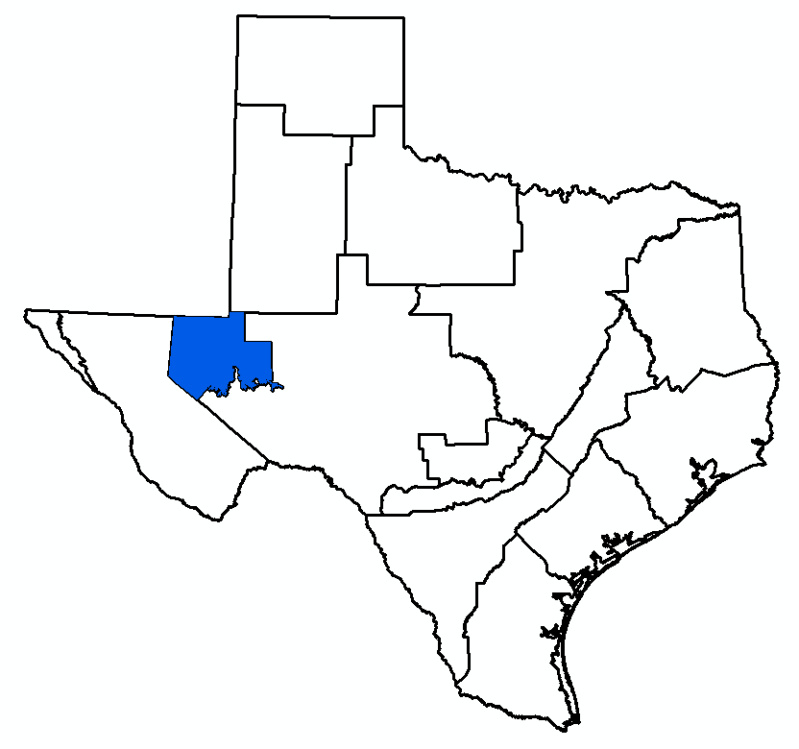
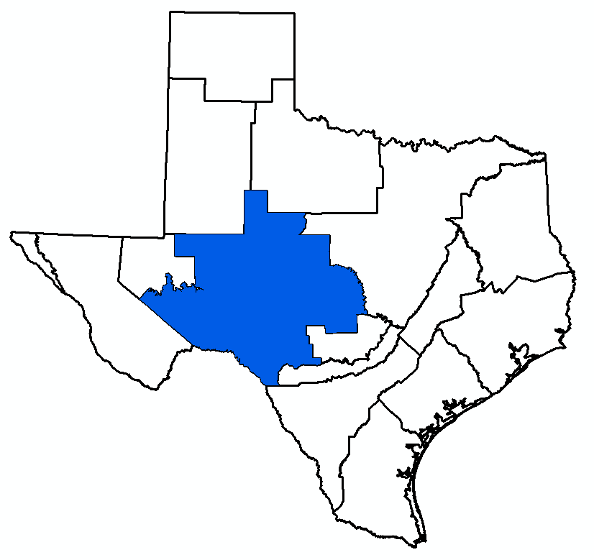
Agenda Item 7: DFC Comparison Updated Calibration of Alternative GAM Updated GAM Simulations Draft Explanatory Reports and Non-Relevant Documentation
Bill Hutchison
GMA 3 and 7 Joint Meeting
March 18, 2026

Slide 2
Topics
DFC Comparison
Updated Calibration of Alternative GAM
Updated GAM Simulations
Draft Explanatory Report and Non-Relevant Documentation

Slide 3
Topics
DFC Comparison
Updated Calibration of Alternative GAM
Updated GAM Simulations
Draft Explanatory Report and Non-Relevant Documentation

Slide 4
DFC Comparison (GMA 3)
Complete
GMA 3 Technical Memorandum 25-01 (Draft - September 5, 2025)
Presented results at GMA 3 meeting on October 22, 2025
Summary of Findings:
Capitan Reef Complex Aquifer
Recommended classification as not relevant for purposes of joint planning
Dockum Aquifer
Recommended classification as not relevant for purposes of joint planning
Edwards-Trinity (Plateau) and Pecos Valley Aquifers
Recommended update to Alternative GAM calibration (Pecos and Reeves counties)
Rustler Aquifer
Recommended classification as not relevant for purposes of joint planning

Slide 5
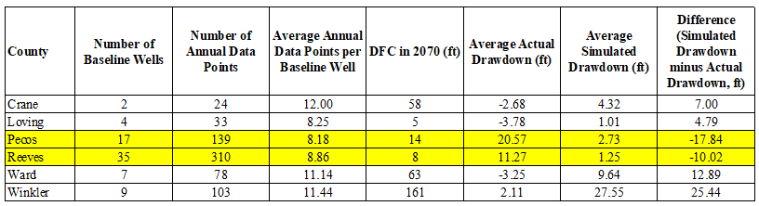
GMA 3 DFC Comparison

Slide 6
DFC Comparison (Phase 1 - GMA 7) (1)
Presented at GMA 7 meeting of August 14, 2025
Summary of Findings
Capitan Reef Complex Aquifer
Recommended classification as not relevant for purposes of joint planning
Edwards-Trinity (Plateau), Pecos Valley, and Trinity Aquifers
Recommended Phase 2 (GCD data and interpolated baselines)
Recommended update of Alternative GAM
Recommended update of MAG approach for Kinney County
Recommended classification of Val Verde County as not relevant for purposes of joint planning

Slide 7
DFC Comparison (Phase 1 - GMA 7) (2)
Presented at GMA 7 meeting of August 14, 2025
Summary of Findings
High Plains Aquifer System (Dockum and Ogallala Aquifers)
Recommended classification as not relevant for purposes of joint planning
Llano Uplift Aquifers
Marble Falls Aquifer: recommended keeping classification as not relevant for purposes of joint planning
Ellenburger-San Saba and Hickory Aquifers: recommended Phase 2 (GCD data and interpolated baselines)
Rustler Aquifer
Recommended classification as not relevant for purposes of joint planning

Slide 8
DFC Comparison (Phase 2 – GMA 7)
Initial work presented at GMA 7 meeting of November 6, 2025
Updated with GCD data (Irion and Sterling counties)
Work on Edwards-Trinity (Plateau), Pecos Valley, and Trinity Aquifers complete
Updated with baseline interpolations (TWDB data)
Work on Llano Uplift (Hickory) is on hold to obtain additional data
Documentation will be completed once the Hickory data is resolved
Invoiced when documentation completed

Slide 9
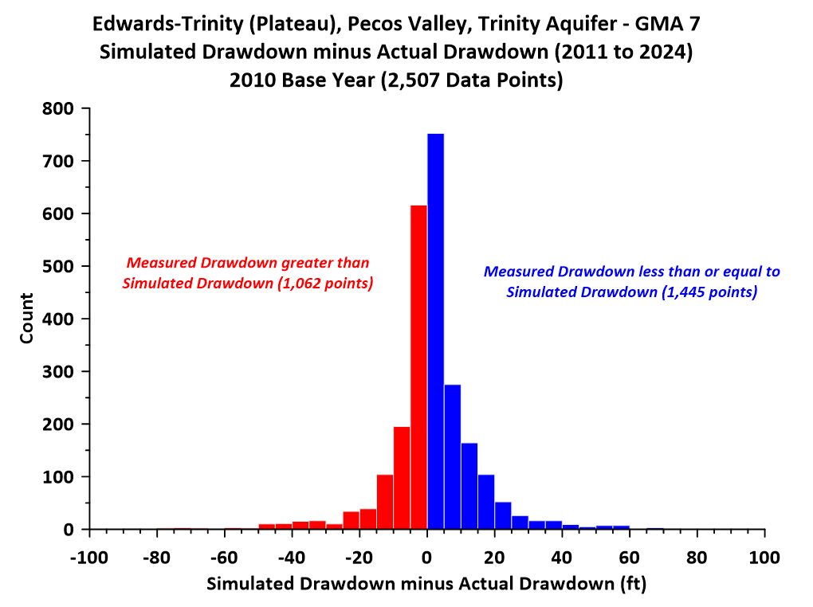
Overall Average Difference = 1.63 ft

Slide 10
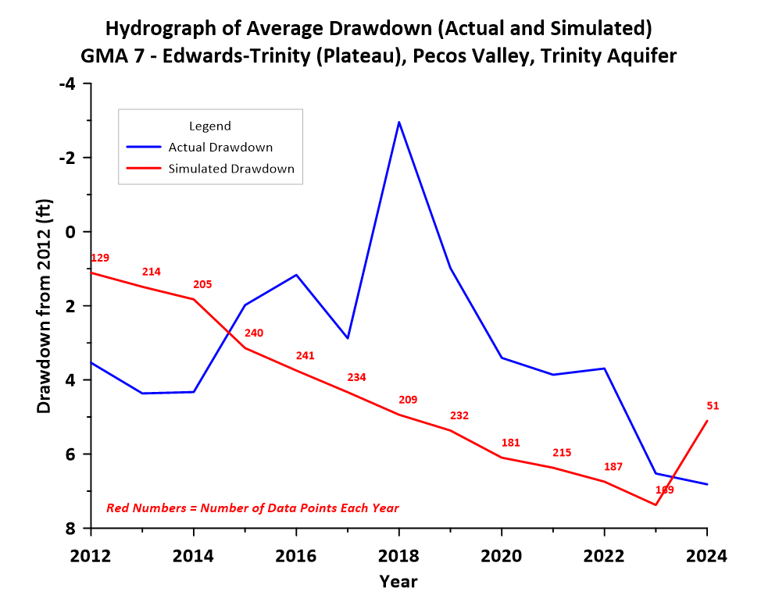

Slide 11
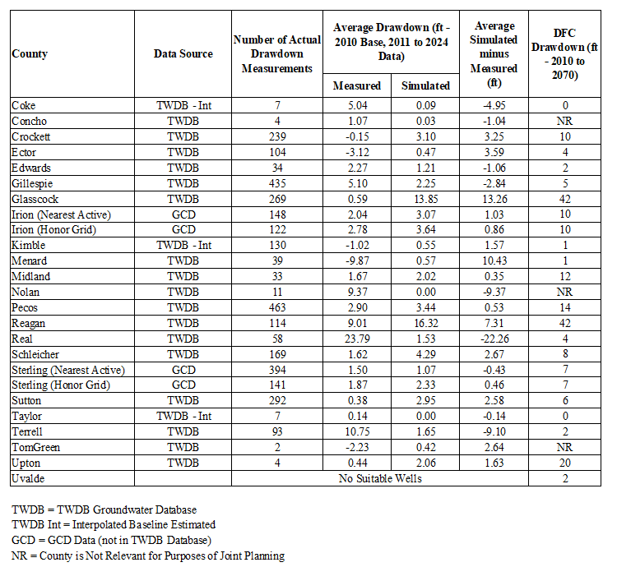
Drawdown Comparison:
Edwards-Trinity (Plateau), Pecos Valley, Trinity Aquifers

Slide 12
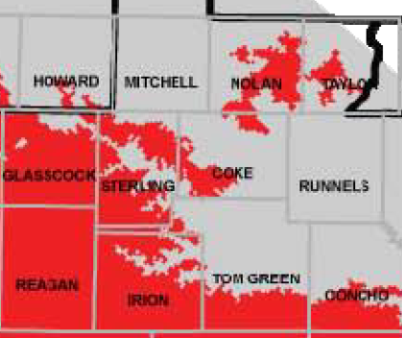
GCD Data Update

Slide 13
Baseline Interpolation Update

Slide 14
Significant “Negative” Differences:
Need to Update the Alternative GAM

Slide 15
Topics
DFC Comparison
Updated Calibration of Alternative GAM
Updated GAM Simulations
Draft Explanatory Report and Non-Relevant Documentation

Slide 16
Updated Calibration of Alternative GAM (GMA 3 and GMA 7)
In GMA 3: Pecos and Reeves counties
Adjustments to transmissivity were successful
Addressed “negative” differences without impacting overall model calibration (Actually, a slight improvement in some calibration statistics)
In GMA 7: Coke, Real, and Terrell counties
Adjustments to transmissivity unsuccessful
Maybe a recharge problem (work in progress)
Work should be completed by end of March (including documentation)

Slide 17
Topics
DFC Comparison
Updated Calibration of Alternative GAM
Updated GAM Simulations
Draft Explanatory Report and Non-Relevant Documentation

Slide 18
Updated GAM Simulations (GMA 3 and GMA 7)
Alternative GAM (Edwards-Trinity (Plateau), Pecos Valley, and Trinity Aquifers)
On hold for Alternative GAM update
Pumping updates received from Plateau UWC&SD
2005 Pumping (GAM Estimate) = 4,209 AF/yr
2023 Pumping (TWDB Estimate) = 4,015 AF/yr
Current MAG = 8,034 AF/yr
GCD Update = 15,640 to 17,354 AF/yr
Last chance to provide update (end of March)
Do we want to run model at next meeting?
2010 DFC/MAG were done at a GMA 7 meeting

Slide 19
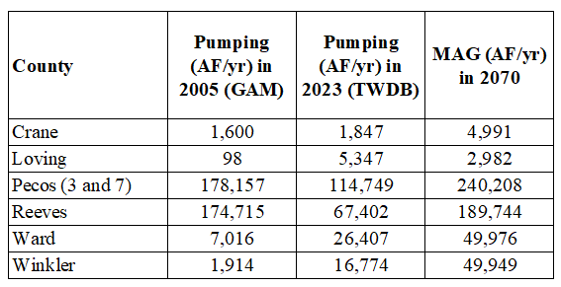
Edwards-Trinity (Plateau) and Pecos Valley Aquifers –
All Counties (GMA 3)

Slide 20
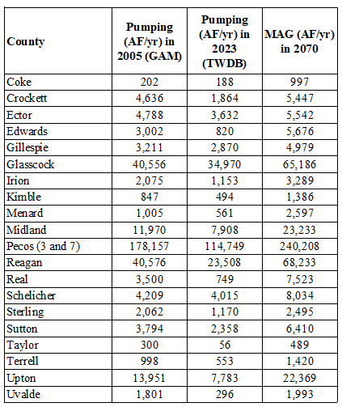
Edwards-Trinity (Plateau), Pecos Valley, and Trinity Aquifers –
Relevant Counties (GMA 7)

Slide 21
Edwards-Trinity (Plateau), Pecos Valley, and Trinity Aquifers –
Relevant Counties (GMA 7)
Requested Pumping = 15,640 to 17,354 AF/yr

Slide 22
Updated GAM Simulations (GMA 7)
Llano Uplift Simulations
Based on input received in 2016 (essentially no increase in pumping from calibration period)
San Angelo pumping of Hickory may be higher than was simulated
Complex litigation issue
Anecdotal groundwater level data (need more complete data)
Need some discussion and clarification
Deadline = March 31, 2026
Model takes almost 2 hours to run (can’t do it at meeting)

Slide 23
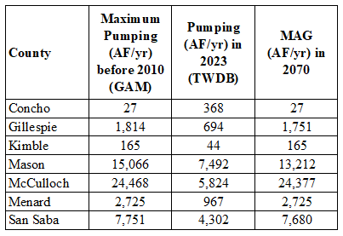
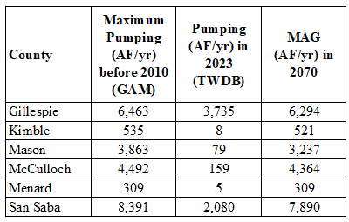
Hickory Aquifer
Ellenburger-San Saba Aquifer

Slide 24
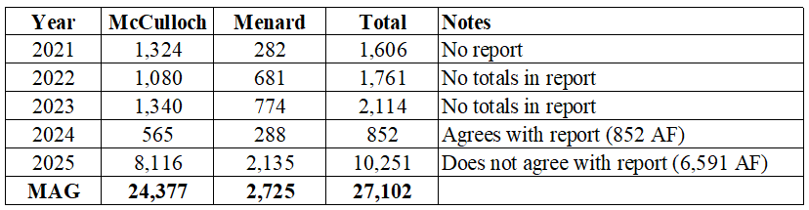
Hickory Aquifer
San Angelo Well Report Totals
(Received March 16, 2026)

Slide 25
Topics
DFC Comparison
Updated Calibration of Alternative GAM
Updated GAM Simulations
Draft Explanatory Report and Non-Relevant Documentation

Slide 26
Draft Explanatory Reports
GMA 3
Edwards-Trinity (Plateau) and Pecos Valley Aquifers
GMA 7
Edwards-Trinity (Plateau), Pecos Valley, and Trinity Aquifers
Llano Uplift Aquifers
On hold for now
Goal is to have them prior to voting on proposed DFC (May 1 deadline)
Statute does not require them until end of process
If we are running models at the next meeting, may be a week or so after voting on proposed DFC

Slide 27
Non-Relevant Documentation – GMA 3
Existing documentation for:
Igneous Aquifer
Ogallala Aquifer
New documentation for:
Capitan Reef Complex Aquifer
Dockum Aquifer
Rustler Aquifer
Will be available prior to voting on a proposed DFC

Slide 28
Non-Relevant Documentation – GMA 7
Existing documentation for:
Blaine Aquifer
Cross Timbers Aquifer
Igneous Aquifer
Lipan Aquifer
Seymour Aquifer
New documentation for:
Capitan Reef Complex Aquifer
Dockum Aquifer
Ogallala Aquifer
Rustler Aquifer
Will be available prior to voting on a proposed DFC

Slide 29
Workplan/Schedule/Budget
GMA 3 Budget and Invoice
GMA 7 Budget and Invoice

Slide 30
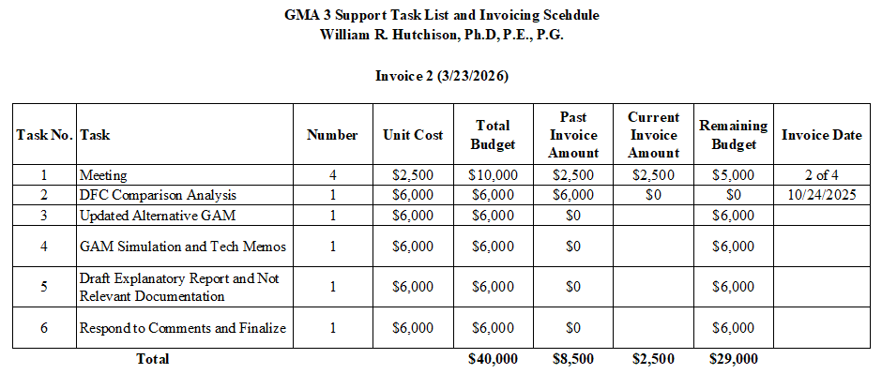
Current Budget Progress (GMA 3)

Slide 31
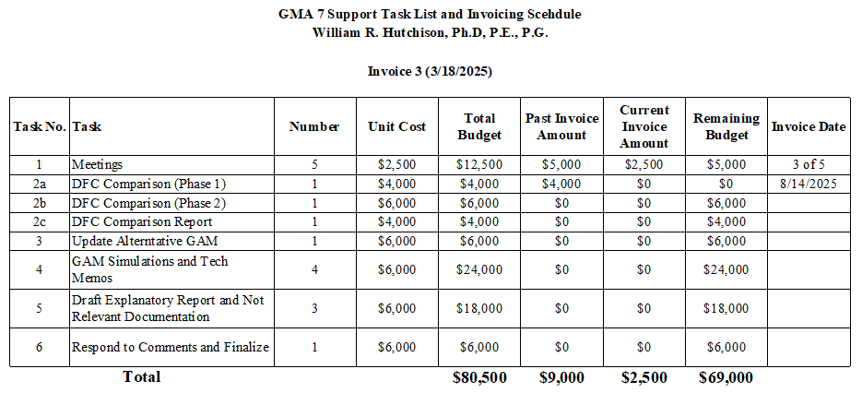
Current Budget Progress (GMA 7)

Slide 32
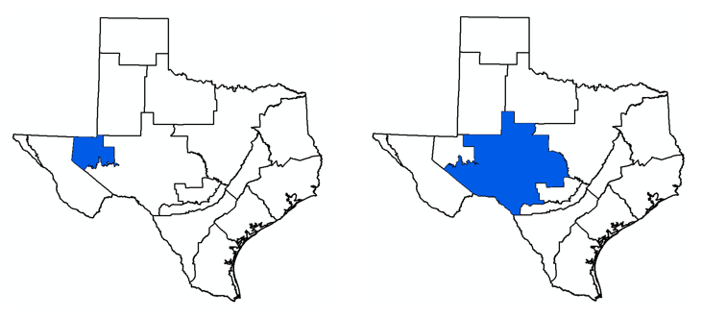
Questions/Discussion Bill Hutchison billhutch@texasgw.com

