Slide 1
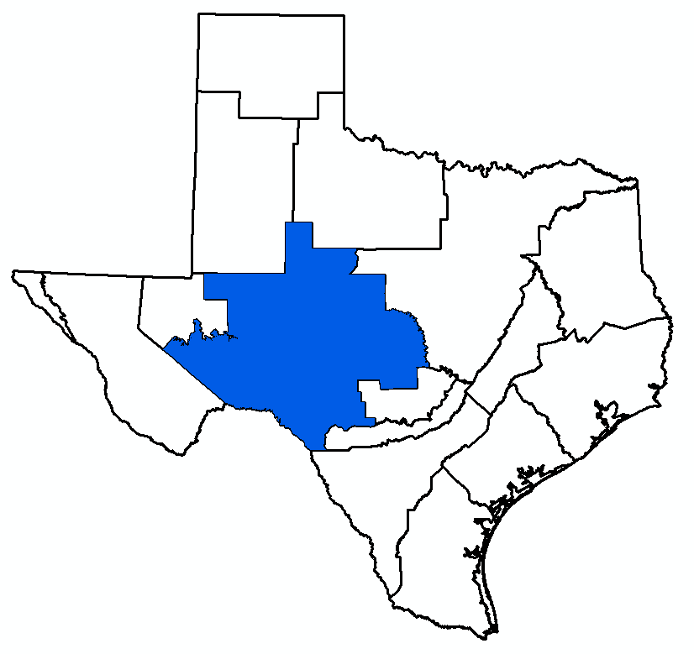
GMA 7 Joint Planning:
Review of 3rd Round and
Next Steps for 4th Round
Bill Hutchison
GMA 7 Meeting
April 10,2025

Slide 2
Topics
Review Joint Planning Process (DFC, MAG)
Review Third Round of Joint Planning
  DFCs adopted on August 19, 2021
Discuss Fourth Round
  HB 2078 Discussion
  Potential Changes to Current DFCs
  Designations of Non-Relevant for Purposes of Joint Planning
    Aquifers
    Portions of Aquifers

Slide 3
Topics
Review Joint Planning Process (DFC, MAG)
Review Third Round of Joint Planning
  DFCs adopted on August 19, 2021
Discuss Fourth Round
  HB 2078 Discussion
  Potential Changes to Current DFCs
  Designations of Non-Relevant for Purposes of Joint Planning
    Aquifers
    Portions of Aquifers

Slide 4
Planning vs. Management vs. Regulation
Planning (Joint Planning Process in GMA 7)
  Desired future conditions (DFC)
  Modeled available groundwater (MAG)
Management (GCD Management Plan)
  Goal 8 (Addressing in a quantitative manner the desired future conditions (DFC) of the groundwater resources in the District)
Regulation (GCD Rules)
  Permitting

Slide 5
Joint Planning
Before 2005
  Regional Planning Groups set “Groundwater Availability”
  No standard approach
  Numerous examples where groundwater availability was not consistent with stated goals
  No formal mechanism where neighboring GCDs were informed of inter-district impacts of planning goals
After 2005
  Mandatory joint planning among GCDs
  Consistent approach in neighboring GCDs
  Formal process to incorporate data and models into planning decisions and the establishment of “available groundwater”

Slide 6
Desired Future Condition (DFC)
Quantified conditions of groundwater
Specified time or times in the future
Broad Policy Goal
  Drawdown
  Spring flow
  Storage volumes
Updated at least every five years

Slide 7
Modeled Available Groundwater (MAG)
The amount of pumping necessary to achieve the desired future condition
TWDB calculates based on
  Model simulations
  Water budget calculations
  District provided data and information
Included in GCD Management Plans
“Groundwater Availability” in Regional Water Plans
One factor in permitting decisions

Slide 8
Groundwater Availability
=
DFC + MAG

Slide 9
Groundwater Availability
=
Policy + Science
Groundwater Availability
=
DFC + MAG

Slide 10
Desired Future Condition (DFC)
Quantified conditions of groundwater resources
Specified time or times in the future
Broad Policy Goal
  Drawdown
  Spring flow
  Storage volumes
Updated at least every 5 years

Slide 11
TWDB Rules after 2005 Legislative Session
No statutory definition of DFC
TWDB added definition of DFC in Administrative Rules (quantified conditions)
  Resulted in the heavy reliance on models
Legislature later adopted TWDB’s definition in 2011 legislation

Slide 12
Groundwater Availability Models (GAMs)
Program started in 2000 to model all aquifers in Texas
Stakeholder involvement
Continuous improvement of the models
Objective of models: define groundwater availability
  Groundwater district management plans
  Regional water planning group plans
Many GAMs were developed before 2005 (i.e. before joint planning)

Slide 13
Model Runs
Simulations of changes in:
  Groundwater pumping and/or
  Drought conditions
Output examples:
  Drawdown
  Spring Flows
  Storage Volumes

Slide 14
Model Runs
Simulations of changes in:
  Groundwater pumping and/or
  Drought conditions
Output examples:
  Drawdown
  Spring Flows
  Storage Volumes
DFC

Slide 15
Model Runs
Simulations of changes in:
  Groundwater pumping and/or
  Drought conditions
Output examples:
  Drawdown
  Spring Flows
  Storage Volumes
MAG

Slide 16
Desired Future Conditions
Model Results
  Important because TWDB uses the models to calculate modeled available groundwater
Data
  Important because models cannot provide “all” the answers and cannot “make decisions”
Common Sense
  Important because a DFC is essentially a policy statement and needs to be rooted in practicality

Slide 17
New DFC Process (2011)
Consider 9 specific factors
“Proposed” DFC
Public comments and public hearings
District summary reports
“Final” DFC
“Explanatory Report”

Slide 18
Nine Factors
Aquifer uses or conditions
State water plan needs and water management strategies
Hydrological conditions
  Recoverable storage (from TWDB)
  Groundwater budget
Other environmental impacts
Subsidence
Socioeconomic impacts
The impact on the interests and rights in private property
The feasibility of achieving the desired future condition
Any other relevant information

Slide 19
In Addition….
The desired future conditions proposed must provide a balance between the highest practicable level of groundwater production and the conservation, preservation, protection, recharging, and prevention of waste of groundwater and control of subsidence in the management area.

Slide 20
In Addition….
The desired future conditions proposed must provide a balance between the highest practicable level of groundwater production and the conservation, preservation, protection, recharging, and prevention of waste of groundwater and control of subsidence in the management area.

Slide 21
In Addition….
The desired future conditions proposed must provide a balance between the highest practicable level of groundwater production and the conservation, preservation, protection, recharging, and prevention of waste of groundwater and control of subsidence in the management area.

Slide 22
In Addition….
The desired future conditions proposed must provide a balance between the highest practicable level of groundwater production and the conservation, preservation, protection, recharging, and prevention of waste of groundwater and control of subsidence in the management area.

Slide 23
Nine Factors and Proposed DFC
Statute requires that these nine factors (and the “balancing”) be considered prior to voting on a “proposed” DFC
  (i.e. prior to any of the public hearings at the each of the Districts)
GMA must consider the nine factors prior to adopting a “proposed” DFC
The final “explanatory” report requires documentation of these factors
Although not required in statute, a “preliminary” explanatory report is useful prior to adoption of the “proposed” DFC

Slide 24
Joint Planning Process Tasks and Timing
Consider 9 specific factors
“Proposed” DFC and Draft Explanatory Report
Public comments and public hearings
District summary reports
“Final” DFC
Final Explanatory Report
Submit to TWDB for Review of Administrative Completness

Slide 25
Joint Planning Process Tasks and Timing
Consider 9 specific factors
“Proposed” DFC and Draft Explanatory Report
Public comments and public hearings
District summary reports
“Final” DFC
Final Explanatory Report
Submit to TWDB for Review of Administrative Completeness
Before 5/1/2026

Slide 26
Joint Planning Process Tasks and Timing
Consider 9 specific factors
“Proposed” DFC and Draft Explanatory Report
Public comments and public hearings
District summary reports
“Final” DFC
Final Explanatory Report
Submit to TWDB for Review of Administrative Completeness
Before 5/1/2026
After Vote on “Proposed” DFC

Slide 27
Joint Planning Process Tasks and Timing
Consider 9 specific factors
“Proposed” DFC and Draft Explanatory Report
Public comments and public hearings
District summary reports
“Final” DFC
Final Explanatory Report
Submit to TWDB for Review of Administrative Completeness
Before 5/1/2026
After Vote on “Proposed” DFC
Deadline to Approve DFC = 1/5/2027

Slide 28
Draft Explanatory Report
Useful for Public Hearings
Documents Factor Consideration
Documents GAM Runs
Appendices include Technical Memoranda (Model Runs)

Slide 29
Topics
Review Joint Planning Process (DFC, MAG)
Review Third Round of Joint Planning
  DFCs adopted on August 19, 2021
Discuss Fourth Round
  HB 2078 Discussion
  Potential Changes to Current DFCs
  Designations of Non-Relevant for Purposes of Joint Planning
    Aquifers
    Portions of Aquifers

Slide 30
15 Aquifers in GMA 7
Blaine
Capitan Reef
Cross Timbers
Dockum
Edwards-Trinity (Plateau)
Ellenburger-San Saba
Hickory
Igneous
Lipan
Marble Falls
Ogallala
Pecos Valley
Rustler
Seymour
Trinity

Slide 31
10 Aquifers in GMA 7 Covered in Explanatory Reports in 2016
Blaine
Capitan Reef
Cross Timbers
Dockum
Edwards-Trinity (Plateau)
Ellenburger-San Saba
Hickory
Igneous
Lipan
Marble Falls
Ogallala
Pecos Valley
Rustler
Seymour
Trinity

Slide 32
Five Explanatory Reports in 2026 (3rd Round)
Organized around Groundwater Availability Models (GAMs)
  Capitan Reef Complex Aquifer
  Edwards-Trinity (Plateau), Pecos Valley, and Trinity aquifers
  Llano Uplift Aquifer System (Ellenburger-San Saba, Hickory)
  Ogallala and Dockum aquifers
  Rustler Aquifer
Briefly summarize each
Recommendations/discussion after completing summary

Slide 33
Capitan Reef Summary
Limited to Middle Pecos GCD in GMA 7
Historic DFCs
  2010: No GAM Available
    DFC = 15 ft drawdown (2010 to 2060) in unconfined area
    DFC = 200 ft drawdown (2010 to 2060) in confined area
  2016: Based on simulations with new GAM
    DFC = 56 ft drawdown (2006 to 2070)
  2021: No change from 2016 DFC
Explanatory report discussed model limitations
  Simulation not reliable but are useful for comparative purposes

Slide 34
Edwards-Trinity (Plateau), Pecos Valley, and Trinity Summary (1)
DFCs based on GAM runs with Alternative GAM
2010 DFC:
  Scenario 10
  Drawdown expressed as GMA 7 average (7 feet) from 2006 to 2060
    Kinney County was expressed separately (Average Las Moras Spring flow of 23.9 cubic feet per second, or cfs) based on a different model
    Some carved out areas were designated as not relevant for purposes of joint planning
    Table of average drawdowns by county were also included in resolution

Slide 35
Edwards-Trinity (Plateau), Pecos Valley, and Trinity Summary (2)
2016 DFC:
  Table of average drawdowns by county based on Scenario 2
    Minor adjustments to 2010 DFC (Irion County)
    Updated time (through 2070)
  Kinney County: no change to 2010 DFC
  Val Verde County: Spring Flow DFC (San Felipe Spring) annual average flow of 73 to 75 million gallons per day (mgd) based on a different model
  Carved out some areas as not relevant (added new areas)
2021 DFC:
  Unchanged from 2016 (2018) DFC

Slide 36
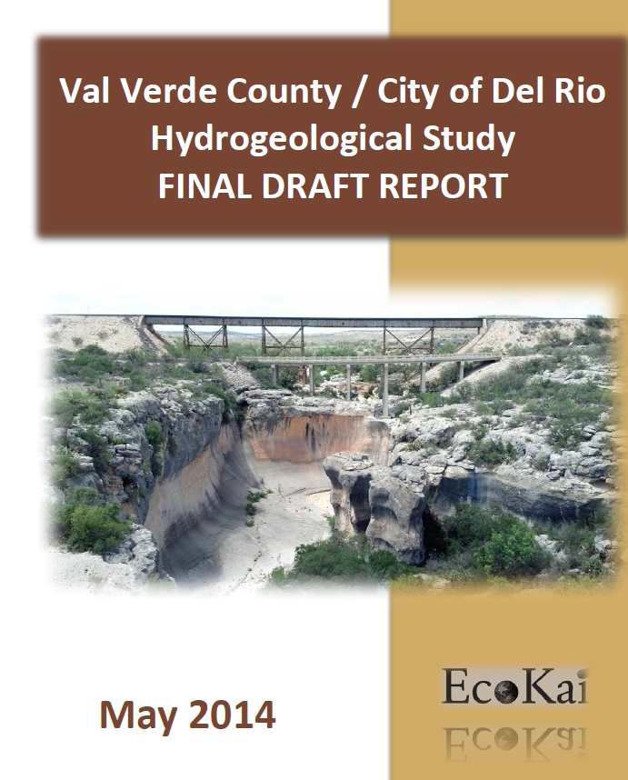
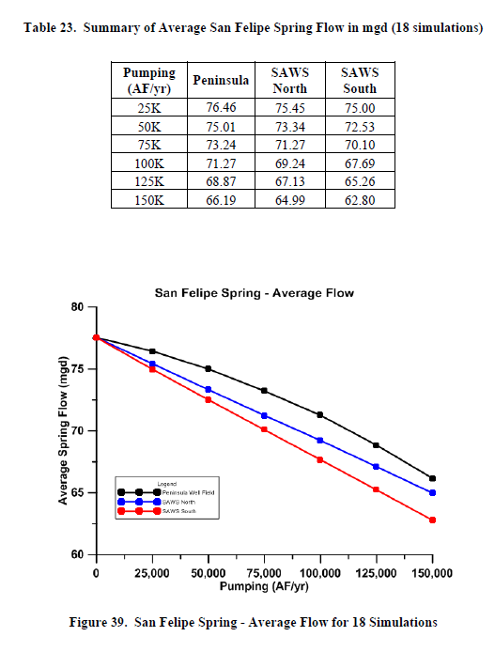

Slide 38
Edwards-Trinity (Plateau), Pecos Valley, and Trinity: Summary of Activities Since 2021
TWDB has started to update GAM
TWDB contracted two research studies (2022)
  Recharge (WSP)
  Pumping (LRE Water)
GMA 7 reviewed these studies
  Presentation on October 20, 2022
  Submitted to TWDB
TWDB provided status of GAM Update at Joint GMA3/GMA 7 meeting on February 19, 2025
  Delays in GAM Update (now Summer/Fall 2025)
  Action at 2/19/2025 meeting: Use “old model” this round and defer any updates to DFC until 5th round of Joint Planning (May 1, 2031)
  TWDB will rely on current Alternative GAM for MAG calculations

Slide 39
Llano Uplift Summary
2010 DFC:
  Ellenburger-San Saba, Hickory, and Marble Falls
  Aquifer drawdown DFCs (2010 to 2060) based on water budget analyses completed by TWDB (three separate reports)
2016 DFC:
  Based on Scenario 3 using Llano Uplift GAM
  Average drawdown in counties from 2011 to 2070
    Separate tables for Ellenburger-San Saba and Hickory
    Marble Falls classified as not relevant
2021 DFC:
  No change from 2016 DFC

Slide 40
Ogallala and Dockum Summary
2010 DFC:
  Ogallala: 50 percent of volume remaining in 2060 (2010 baseline) in Ector, Glasscock, and Midland counties (based on Ogallala GAM)
  Dockum: Average drawdown by county based on Dockum Alternative GAM) for Ector, Midland, Mitchell, Nolan, Pecos, Scurry, and Upton counties
2016 DFC:
  Based on new HPAS GAM
  Ogallala: average drawdown of 6 ft in Glasscock County (2012 to 2070). Not relevant in other counties
  Dockum: average drawdown (2012 to 2070) in Reagan and Pecos County. Not relevant in other counties
2021 DFC:
  No change from 2016 DFC

Slide 41
Ogallala and Dockum: Summary of Activities Since 2021
TWDB updates to HPAS GAM
Increased Dockum wells and added pumping from 2013 to 2020
Extended calibration period to 2020
Need to consider this GAM update (if Ogallala and Dockum are designated as “relevant”):
  New simulations
  Update “current” simulations

Slide 42
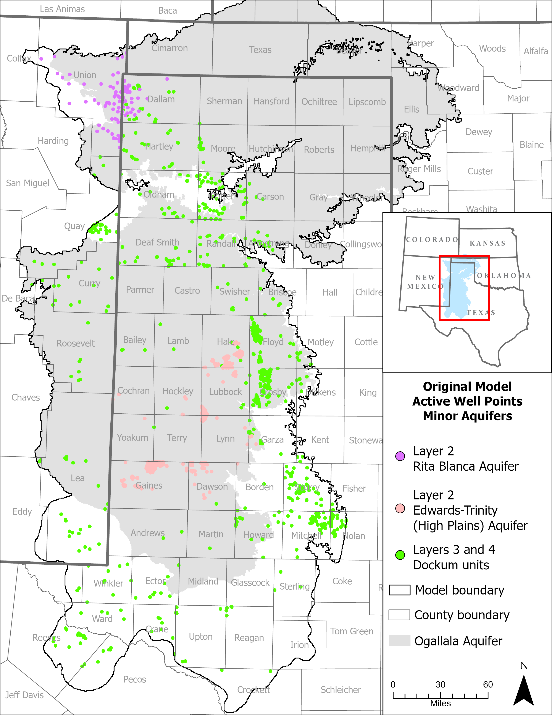
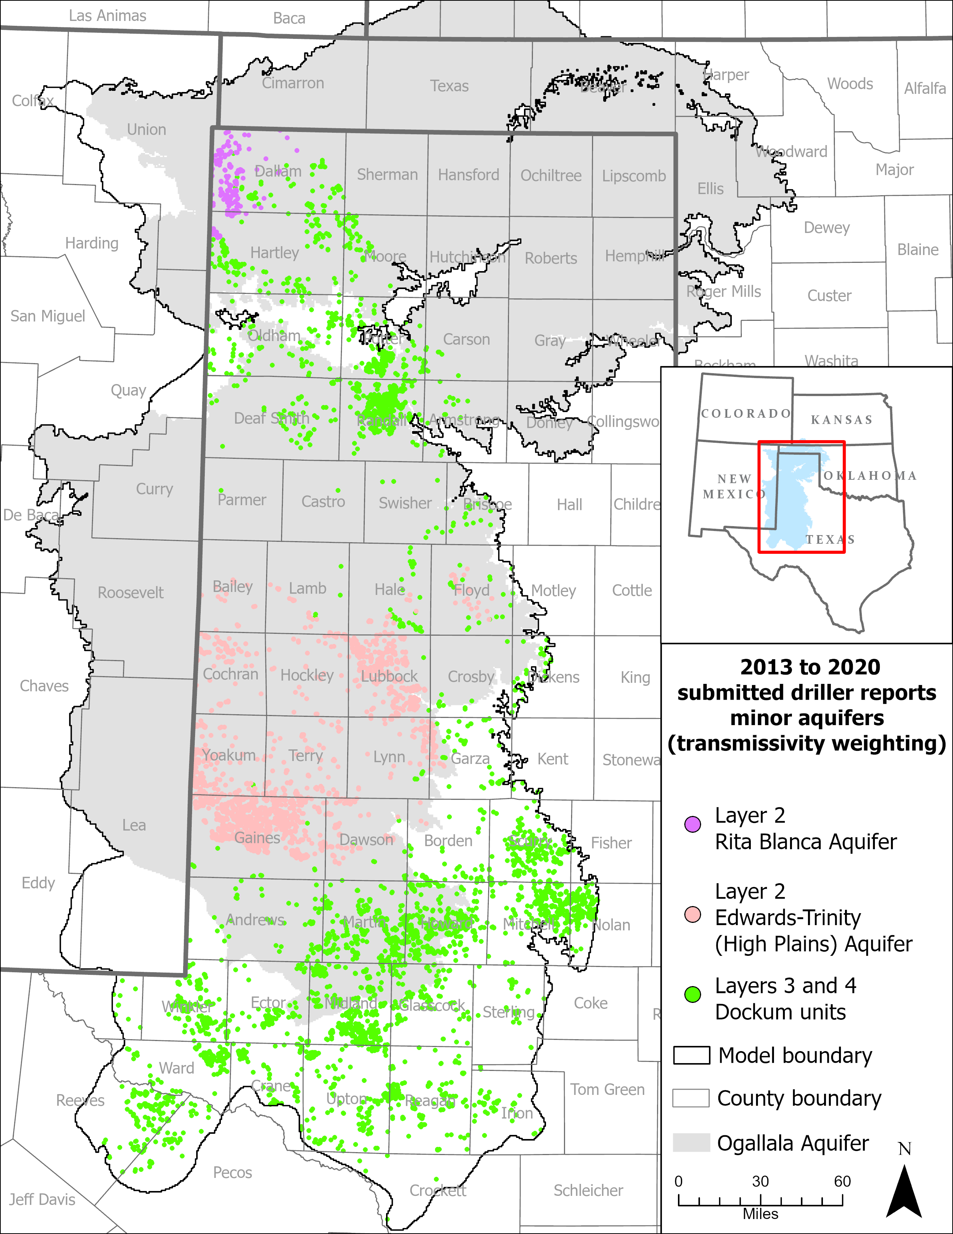

Slide 43
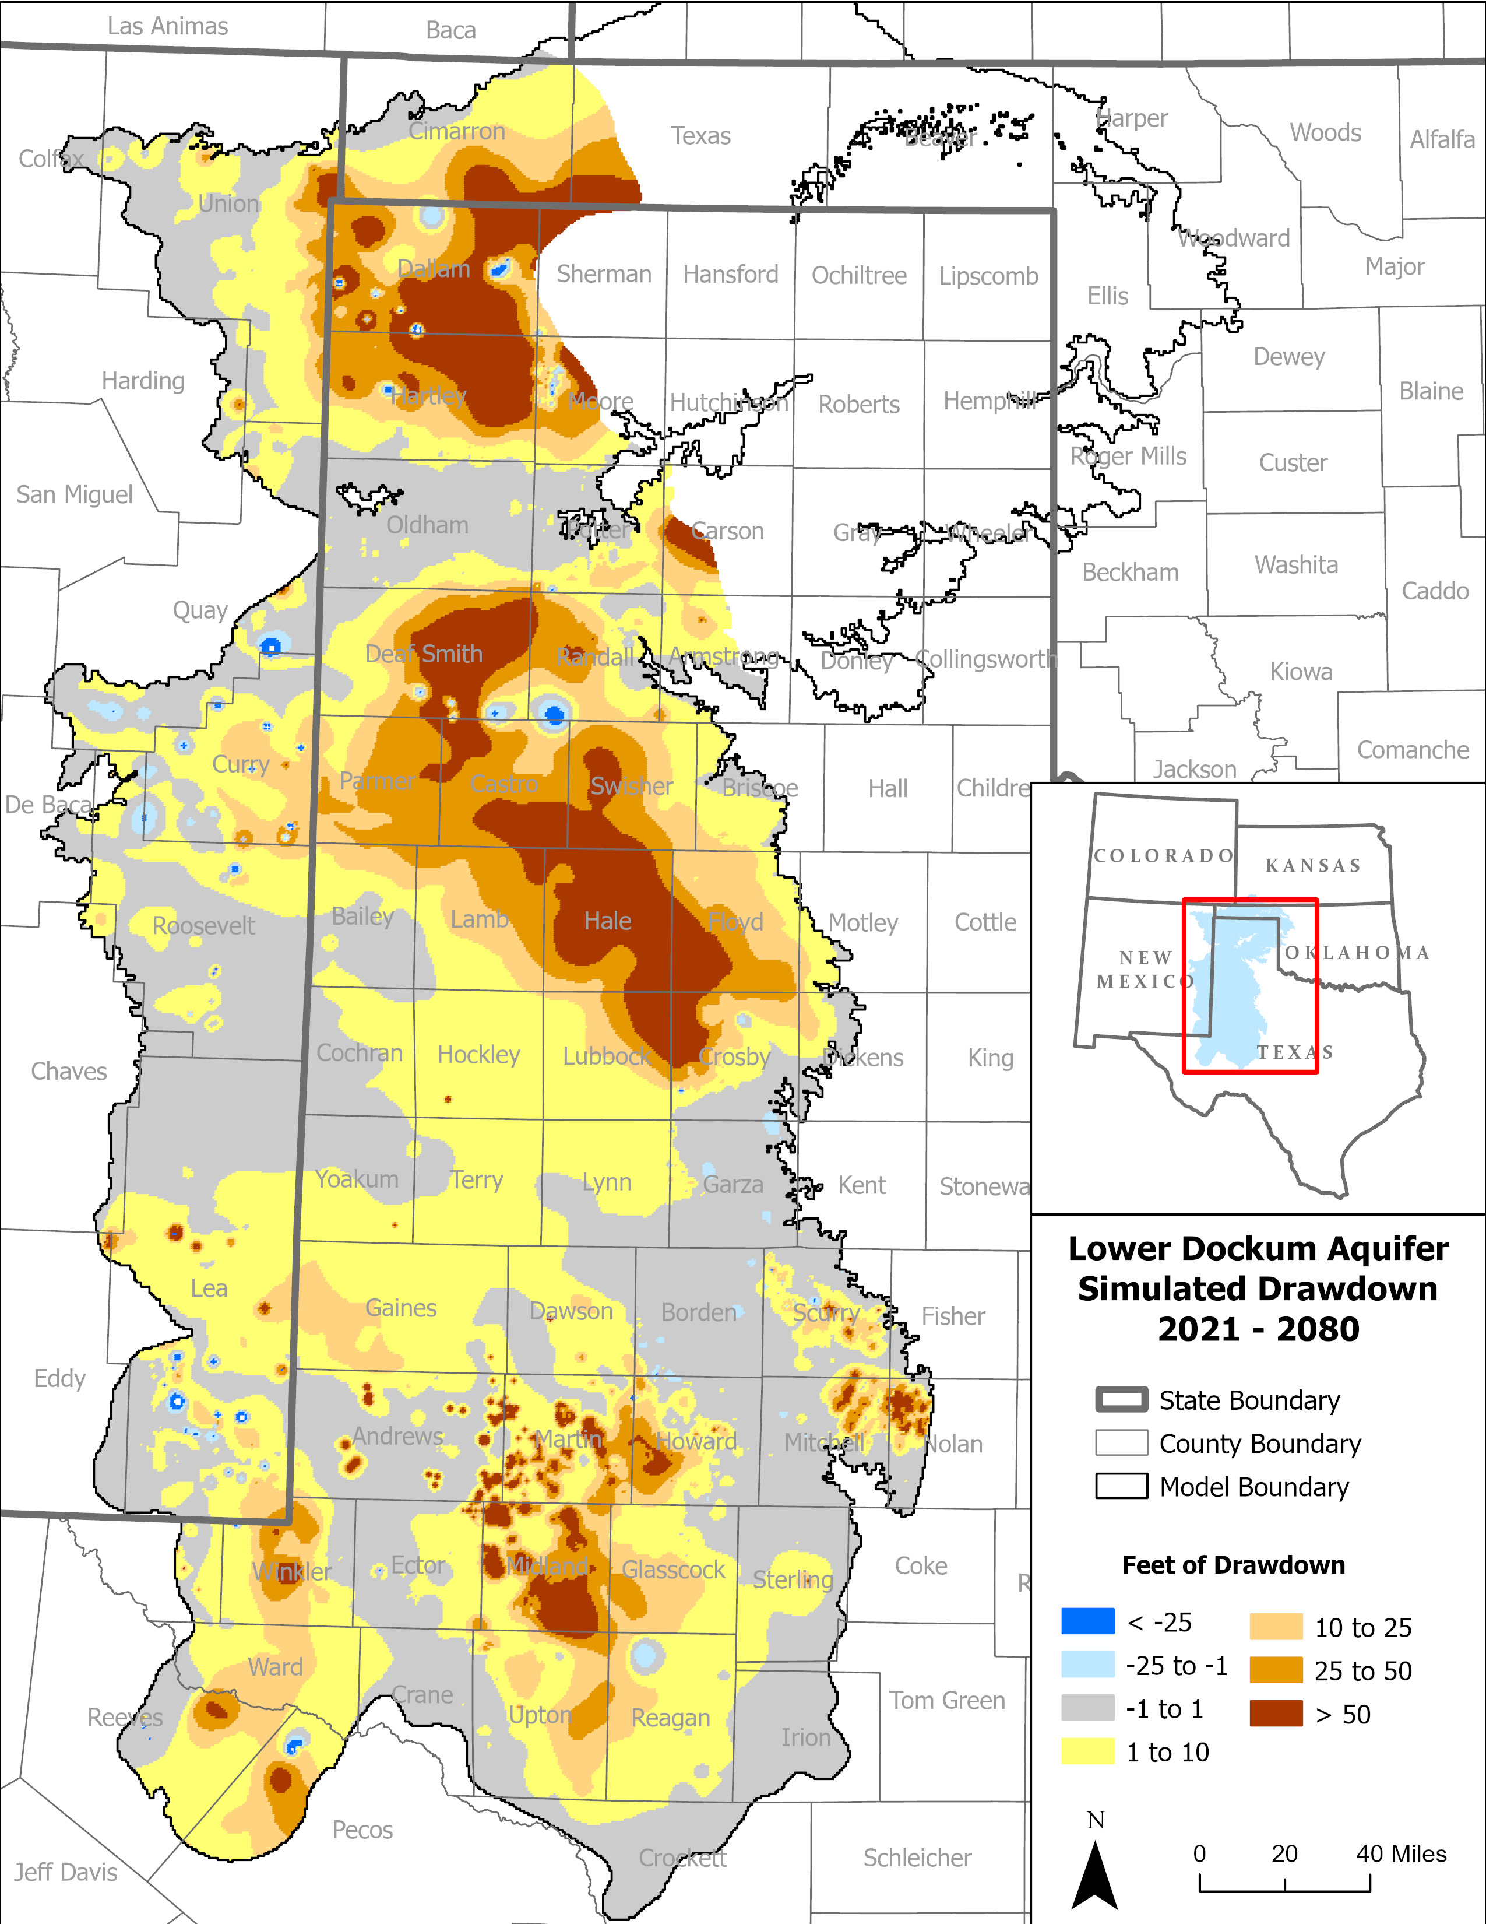

Slide 44
Rustler Summary
2010 DFC:
  “Net decline in water levels” shall not exceed 300 feet from 2010 to 2016 in Pecos County
  Based on water budget analysis
2016 DFC
  Based on Rustler GAM
    Limitation: must specify overlying formation heads (declining, stable, rising)
  Scenario 4 (0.5 ft/yr decline in overlying heads) was basis for DFC
    94 feet of drawdown from 2009 to 2070 in Pecos County
2021 DFC
  No change in 2016 DFC

Slide 45
Aquifers Not Relevant for Purposes of Joint Planning in GMA 7
Blaine
Capitan Reef
Cross Timbers
Dockum
Edwards-Trinity (Plateau)
Ellenburger-San Saba
Hickory
Igneous
Lipan
Marble Falls
Ogallala
Pecos Valley
Rustler
Seymour
Trinity

Slide 46
What Does “Not Relevant for Purposes of Joint Planning” Mean?
From TWDB:
  Districts in a GMA decide which aquifers are relevant and not relevant for joint planning purposes.
  Parts of a relevant aquifer that do not warrant a DFC based on aquifer characteristics, groundwater demands, and current groundwater uses
Must document technical justification
Local (district) management is not affected

Slide 47
What Happens to Groundwater Availability with Not Relevant Designation?
Regional water planning groups determine groundwater availability
TWDB provides “DFC-compatible” availability volumes based on GAM runs
Regional planning groups may choose to adjust that availability

Slide 48
Not Relevant Aquifer Documentation
August 27, 2021
Five Tech Memos (15-01 to 15-04 and 20-01)
Covers Items Required by TWDB
Please recall: Marble Falls also considered not relevant for purposes of joint planning – covered in Llano Uplift Explanatory Report

Slide 49
Topics
Review Joint Planning Process (DFC, MAG)
Review Third Round of Joint Planning
  DFCs adopted on August 19, 2021
Discuss Fourth Round
  HB 2078 Discussion
  Potential Changes to Current DFCs
  Designations of Non-Relevant for Purposes of Joint Planning
    Aquifers
    Portions of Aquifers

Slide 50
HB 2078
Referred to Natural Resources on March 14, 2025
Includes provision for management plans to include “an explanation in plain language”
  Monitoring and tracking the achievement of the DFC
  How the district has performed in meeting the DFC over the preceding five-year period
Includes a provision for GMAs to consider the degree to which each district is achieving the DFC through implementation of the district’s management plan and rules
Includes a provision that adds to the explanatory report:
  Why a DFC was changed
  Summary of how each district is performing in achieving the DFCs

Slide 51
HB 2078 Implications for the 4th Round of Joint Planning
Factor in “not relevant” designations
  Monitoring capabilities
Discussion of GMA-wide standard of comparing actual data with model results (basis for DFC simulation)
  Currently completed annually for MPGCD
  Examples of GMA-wide approach in GMA 11 and GMA 14 (completed for Bluebonnet GCD)
  Could be added as a task for GMA 7

Slide 52
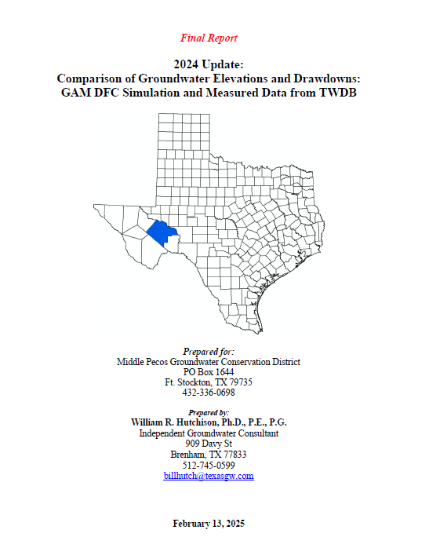
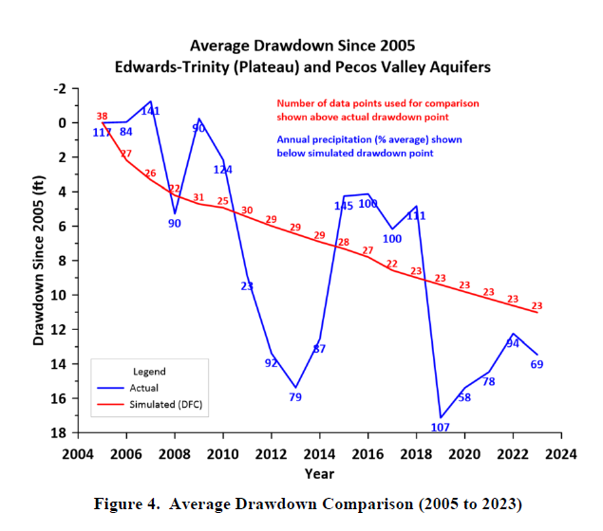

Slide 53
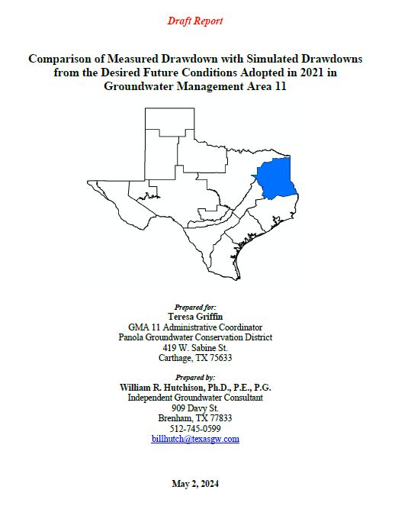
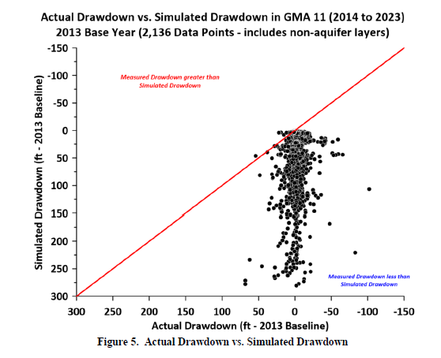

Slide 54
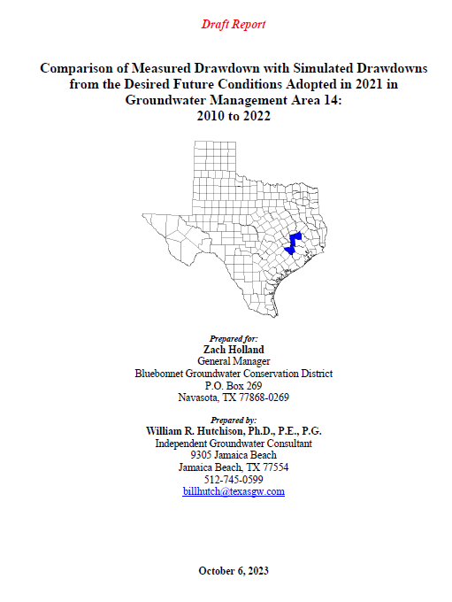
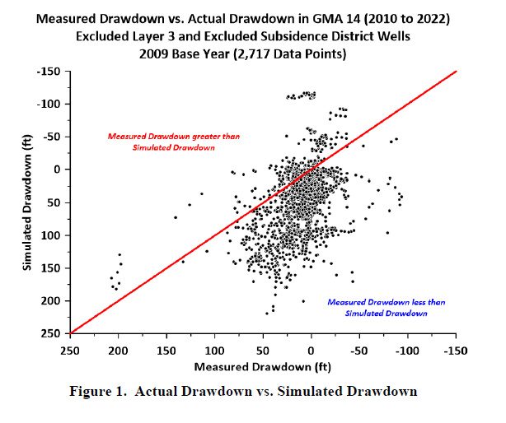

Slide 55
DFC Comparison
Baseline Year (generally based on GAM calibration)
  DFC simulations start at end of calibration period
Average Spring Flow: compare annual flow to long term average
  Kinney County (Las Moras Spring)
    Spring flow affected by rainfall and pumping
    Indexed based on annual rainfall
    Method and approach covered in KCGCD Management Plan
  Val Verde County
    Spring flow affected by rainfall and Amistad elevation (minimal pumping)
    Spring flow correlated with nearby groundwater elevations
    No method currently exists to assess “achievement”
    No GCD exists to develop (GMA 7 responsibility if HB 2078 is adopted?)

Slide 56
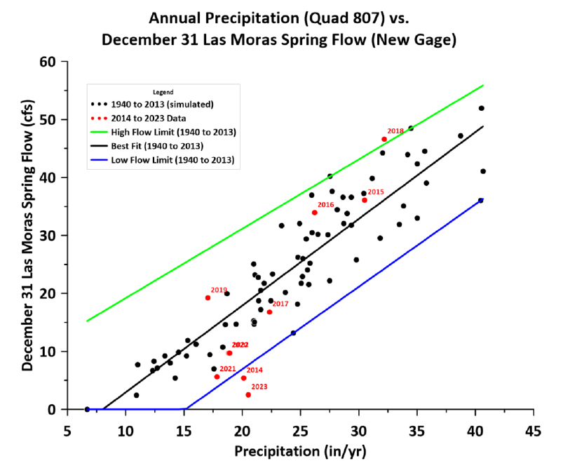

Slide 57
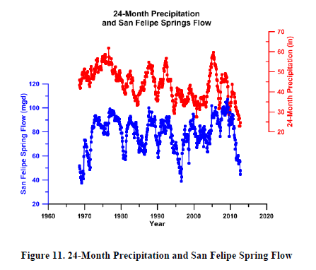
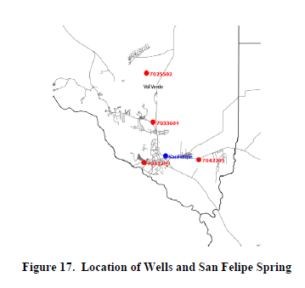
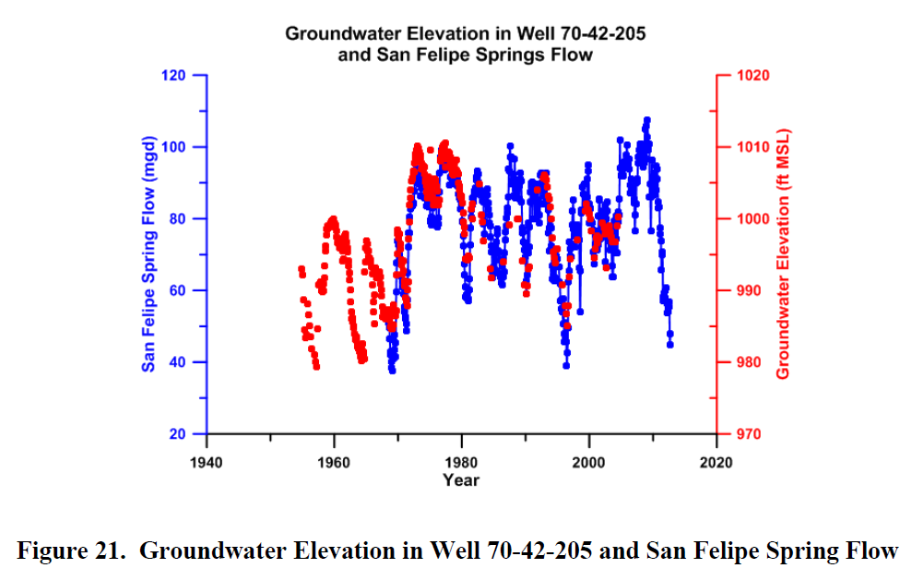
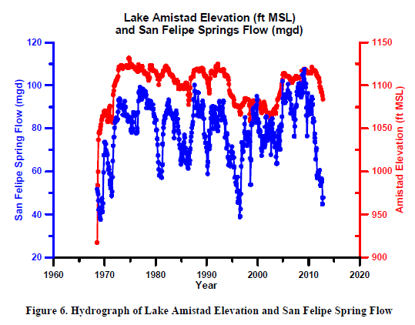

Slide 58
Discussion of Possible Changes to 2016 DFCs (1)
Capitan Reef Complex Aquifer
  Candidate for “not relevant” designation
Edwards-Trinity (Plateau), Pecos Valley, and Trinity aquifers
  Not a candidate for “not relevant” designation (except for some specified areas that have been designated in previous DFCs)
  Some discussion at previous meeting of minor adjustments to GAM run
  Kinney County (MAG issues)
  Val Verde County (candidate for “not relevant” designation)
Llano Uplift Aquifer System (Ellenburger-San Saba, Hickory)
  Not a candidate for “not relevant” designation
  Other adjustments?

Slide 59
Discussion of Possible Changes to 2016 DFCs (2)
Ogallala and Dockum
  Ogallala limited to Glasscock County
    Single county makes it a candidate for “not relevant” designation
  Dockum limited to Pecos and Reagan counties
    Limited use in Pecos County (also no monitoring well data in baseline year)
    TWDB estimated use in Reagan County (less than 100 AF/yr)
    Candidates for “not relevant” designation
  New HPAS would require an updated GAM simulation
Rustler
  Limited to Pecos County (single county in GMA 7)
  No monitoring well data in baseline year
  Candidate for “not relevant” designation

Slide 60
Summary of Next Steps
Based on today’s input, develop scope of work for 4th round of joint planning
  Tasks:
    Meetings
    Comparing data with DFCs (?)
    GAM simulations (technical memoranda)
    Draft explanatory reports (includes nine factor presentations at meetings) and draft documentation for “not relevant” aquifers
    Review public comments received from district public hearings, respond to comments, finalize explanatory reports and tech memos
Next meeting: approve scope and budget

Slide 61
2021 Budget
Task | Number | Unit Cost | Total Cost
Meetings | 5 | $2,500 | $12,500
Draft Explanatory Reports and Not Relevant Documentation | 6 | $5,000 | $30,000
Respond to Comments and Finalize | 1 | $5,000 | $5,000
Total |  |  | $47,500

Slide 62
“Skeleton” of 2026 Budget
Task | Number | Unit Cost | Total Cost
Meetings | 5 | $2,500 | $12,500
DFC Comparison Analysis (?) | 1 | $6,000 | $6,000
GAM Simulations and Tech Memos | ? | $6,000
Draft Explanatory Reports and Not Relevant Documentation | ? | $6,000
Respond to Comments and Finalize | 1 | $6,000 | $6,000
Total |  |  | ??

Slide 63
Possible Meeting Schedule*
July 2025: Approve scope and budget
  Could include DFC Comparison if authorized before full budget completed
October 2025: DFC Comparison (?), not relevant documentation and GAM simulations
January 2026: Draft Explanatory Reports (includes 9 factors discussion)
April 2026: Updates based on input/discussion from January meeting (i.e. updated draft explanatory report), vote on proposed DFCs
October 2026: Review public comments, proposed responses, draft final Explanatory Reports, vote on final DFCs
* Subject to change due to TX v NM trial

